Slide 1
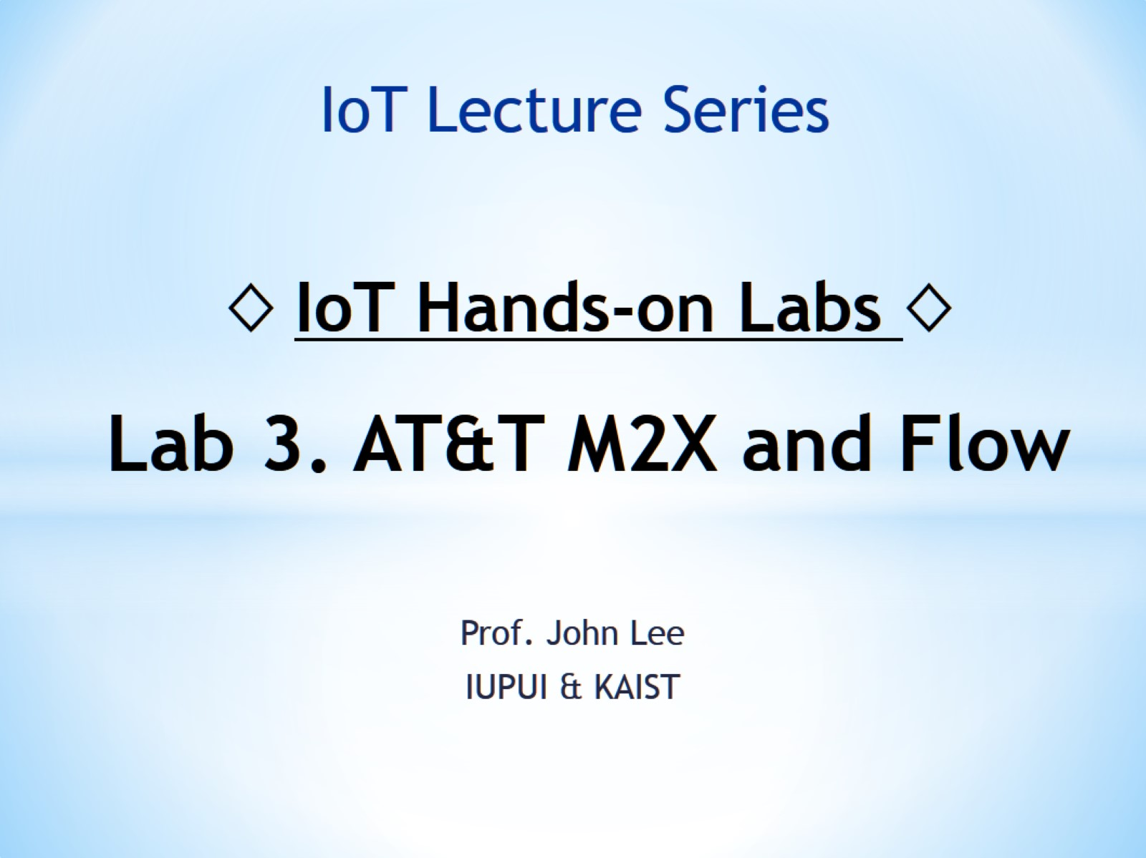
◊ IoT Hands-on Labs ◊ Lab 3. AT&T M2X and Flow

Slide 2
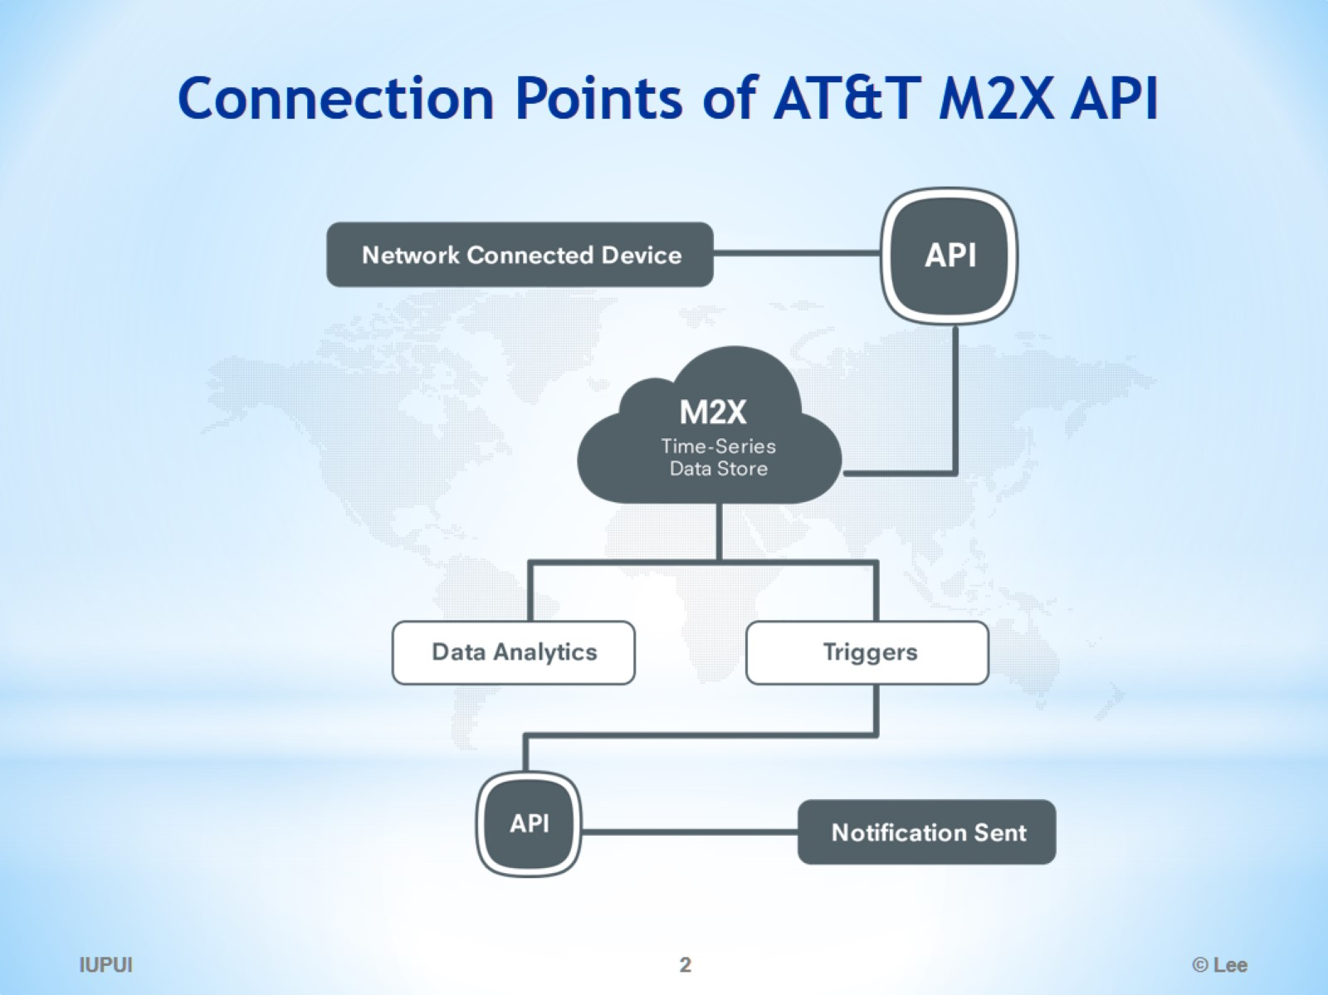
Connection Points of AT&T M2X API

Slide 3
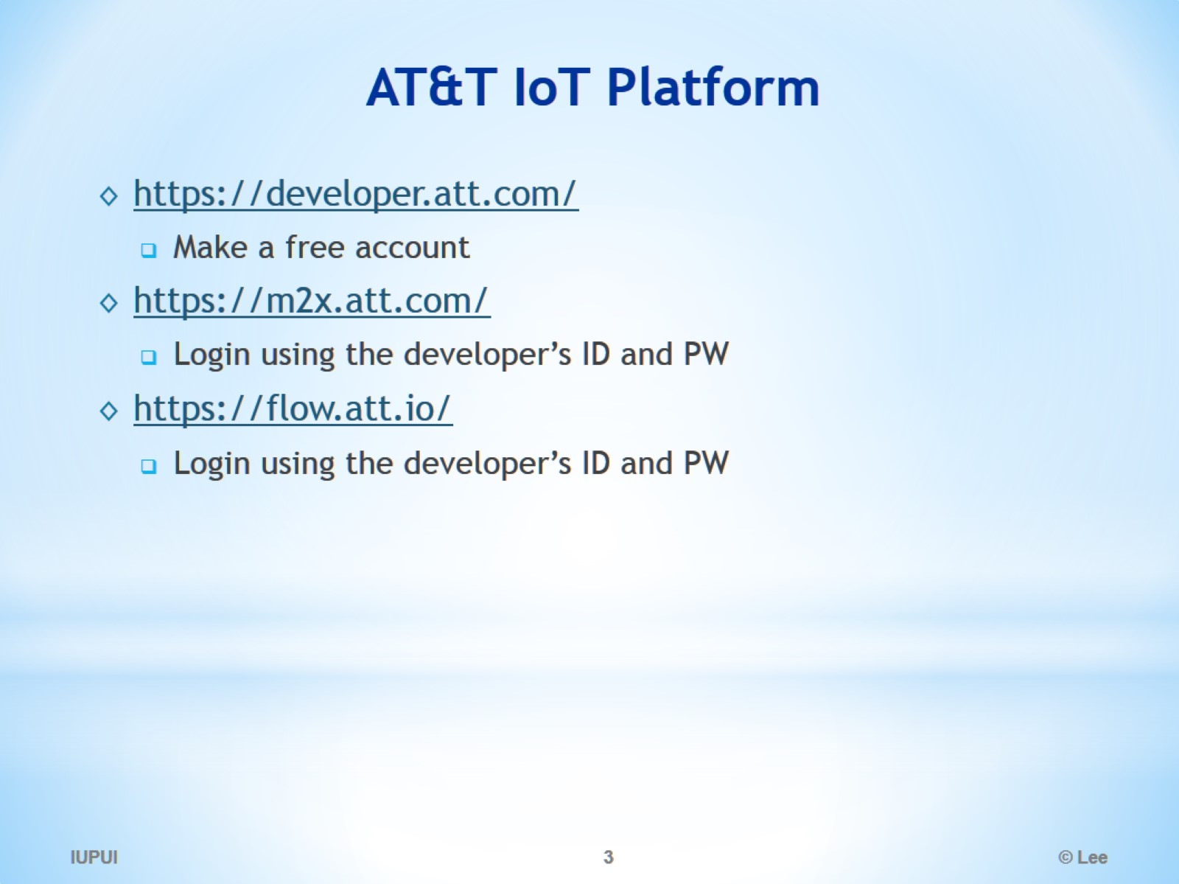
AT&T IoT Platform

Slide 4
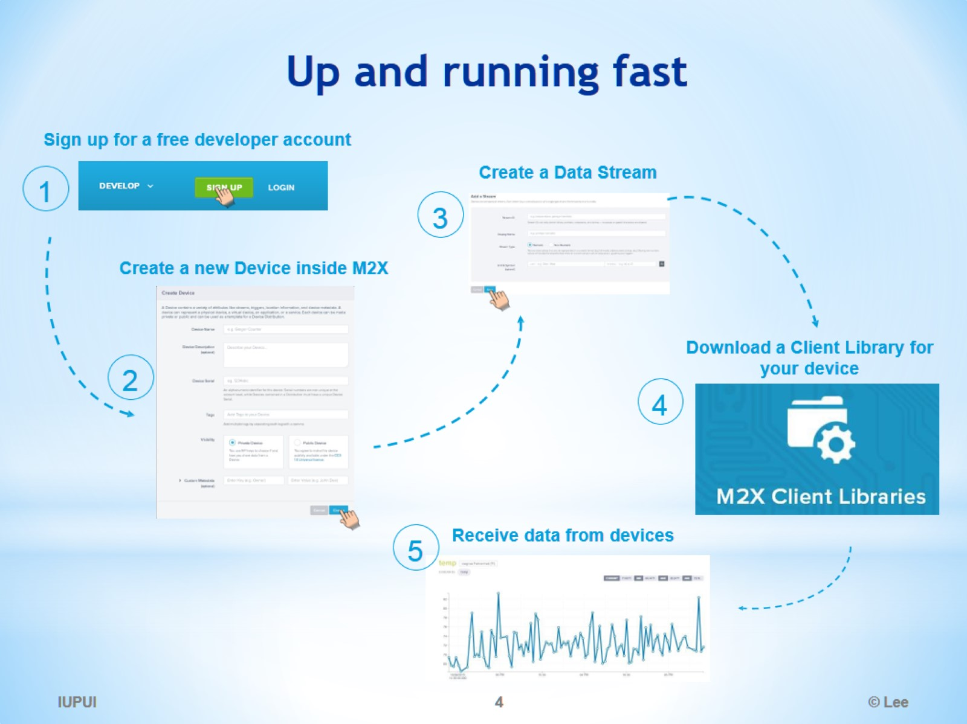
Up and running fast

Slide 5
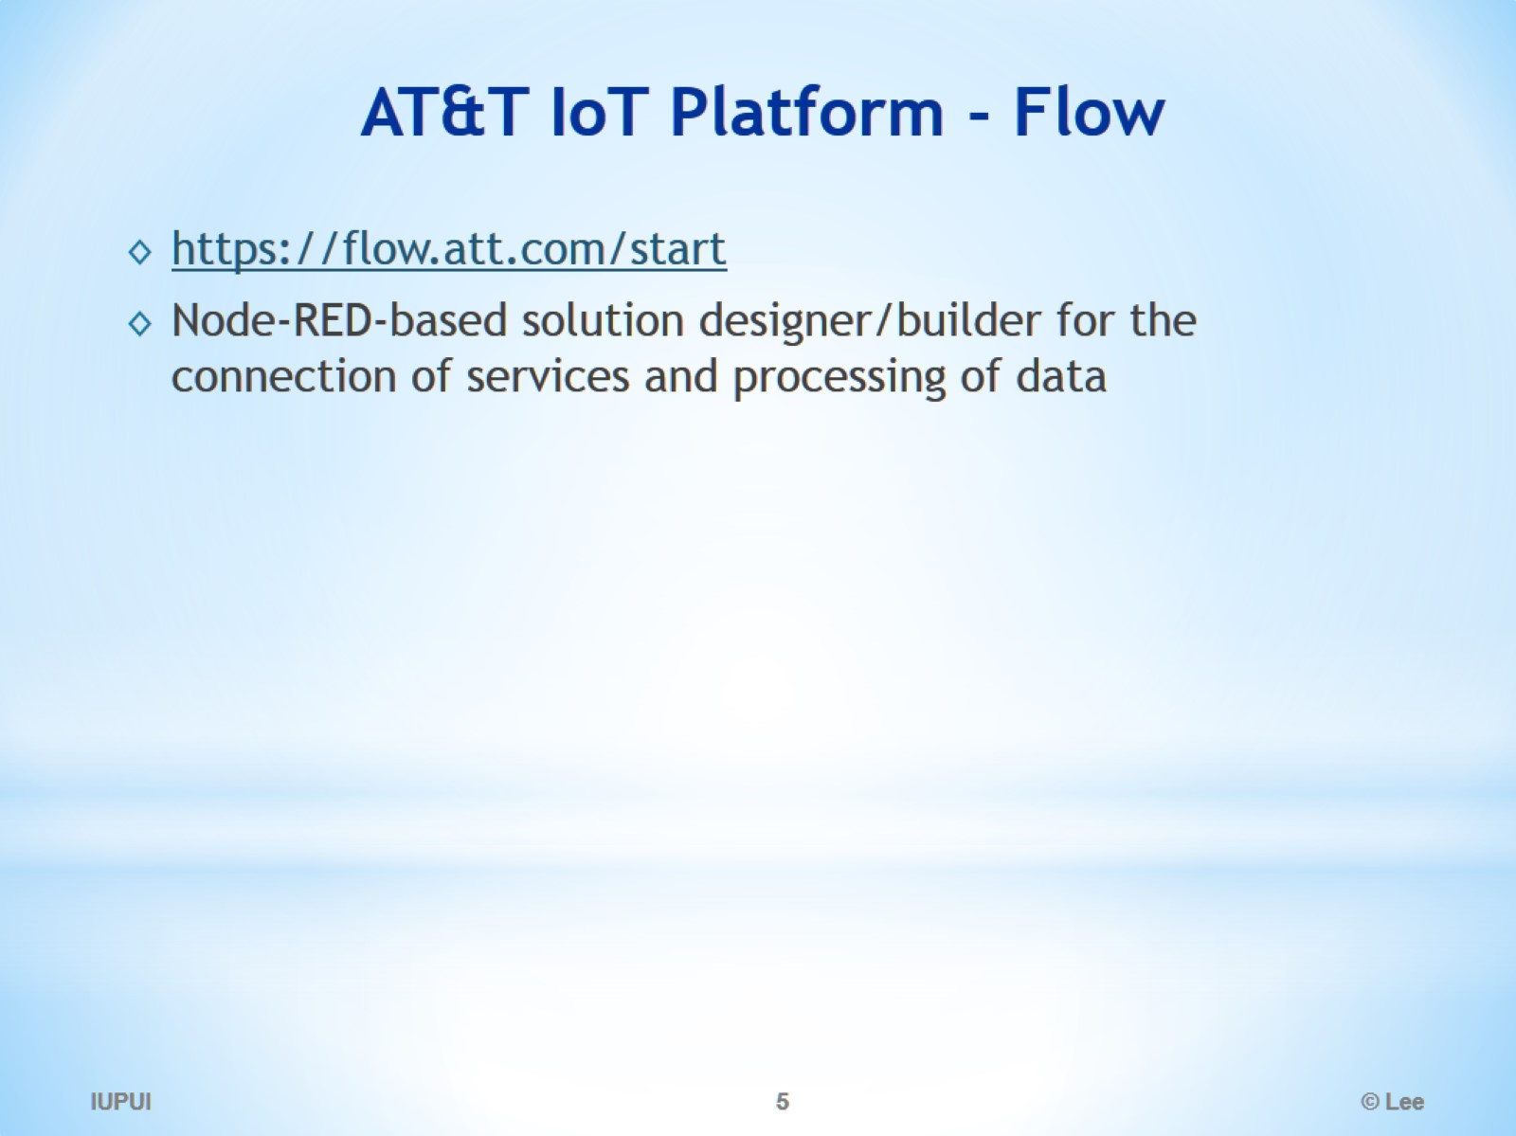
AT&T IoT Platform - Flow

Slide 6
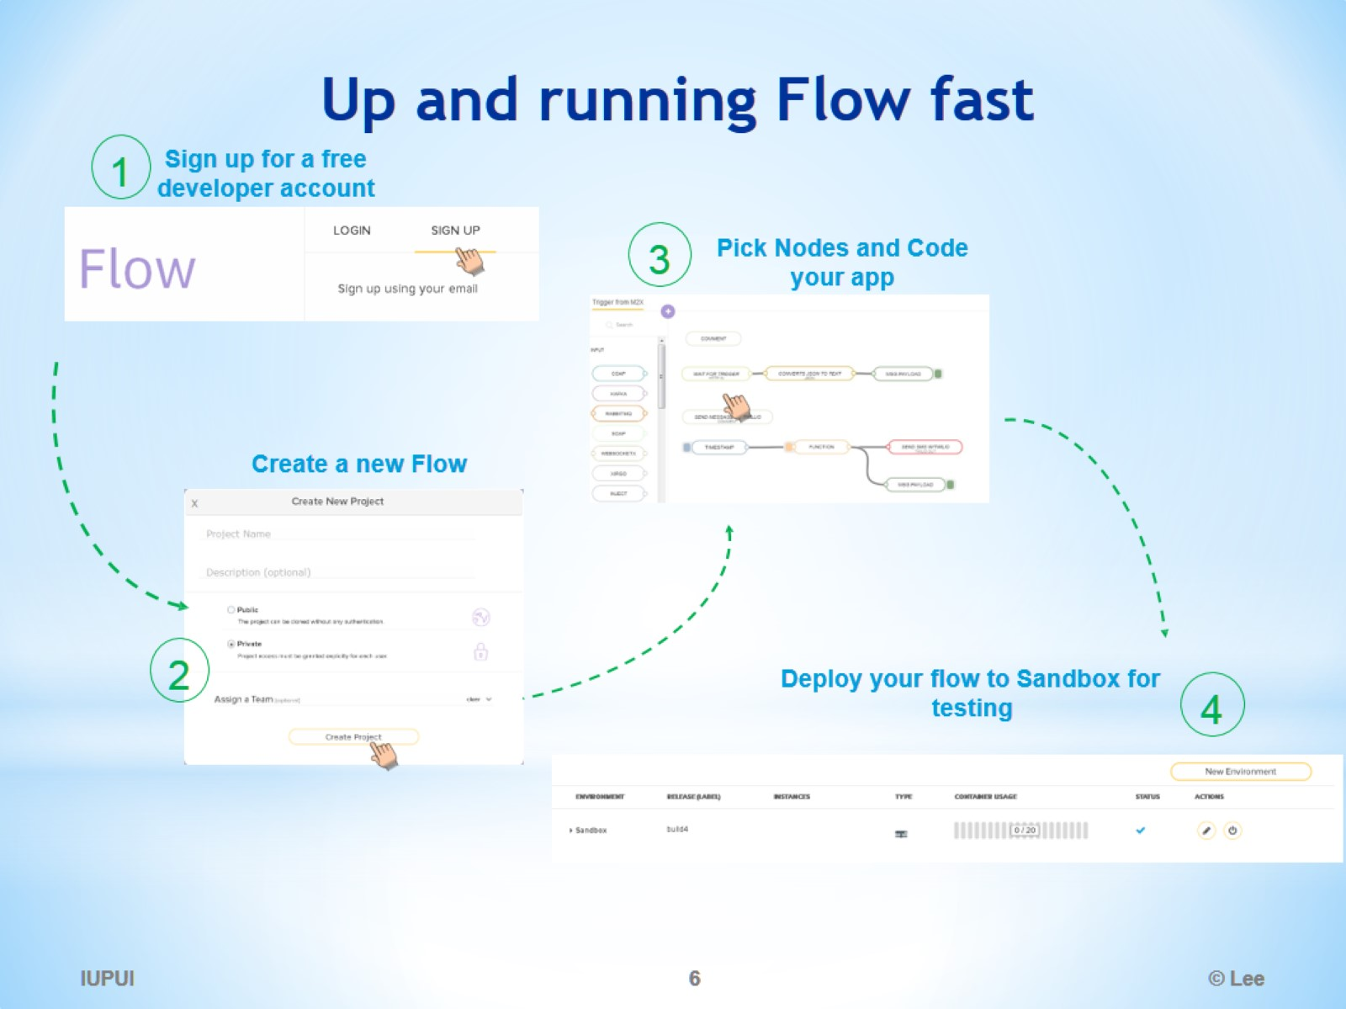
Up and running Flow fast

Slide 7
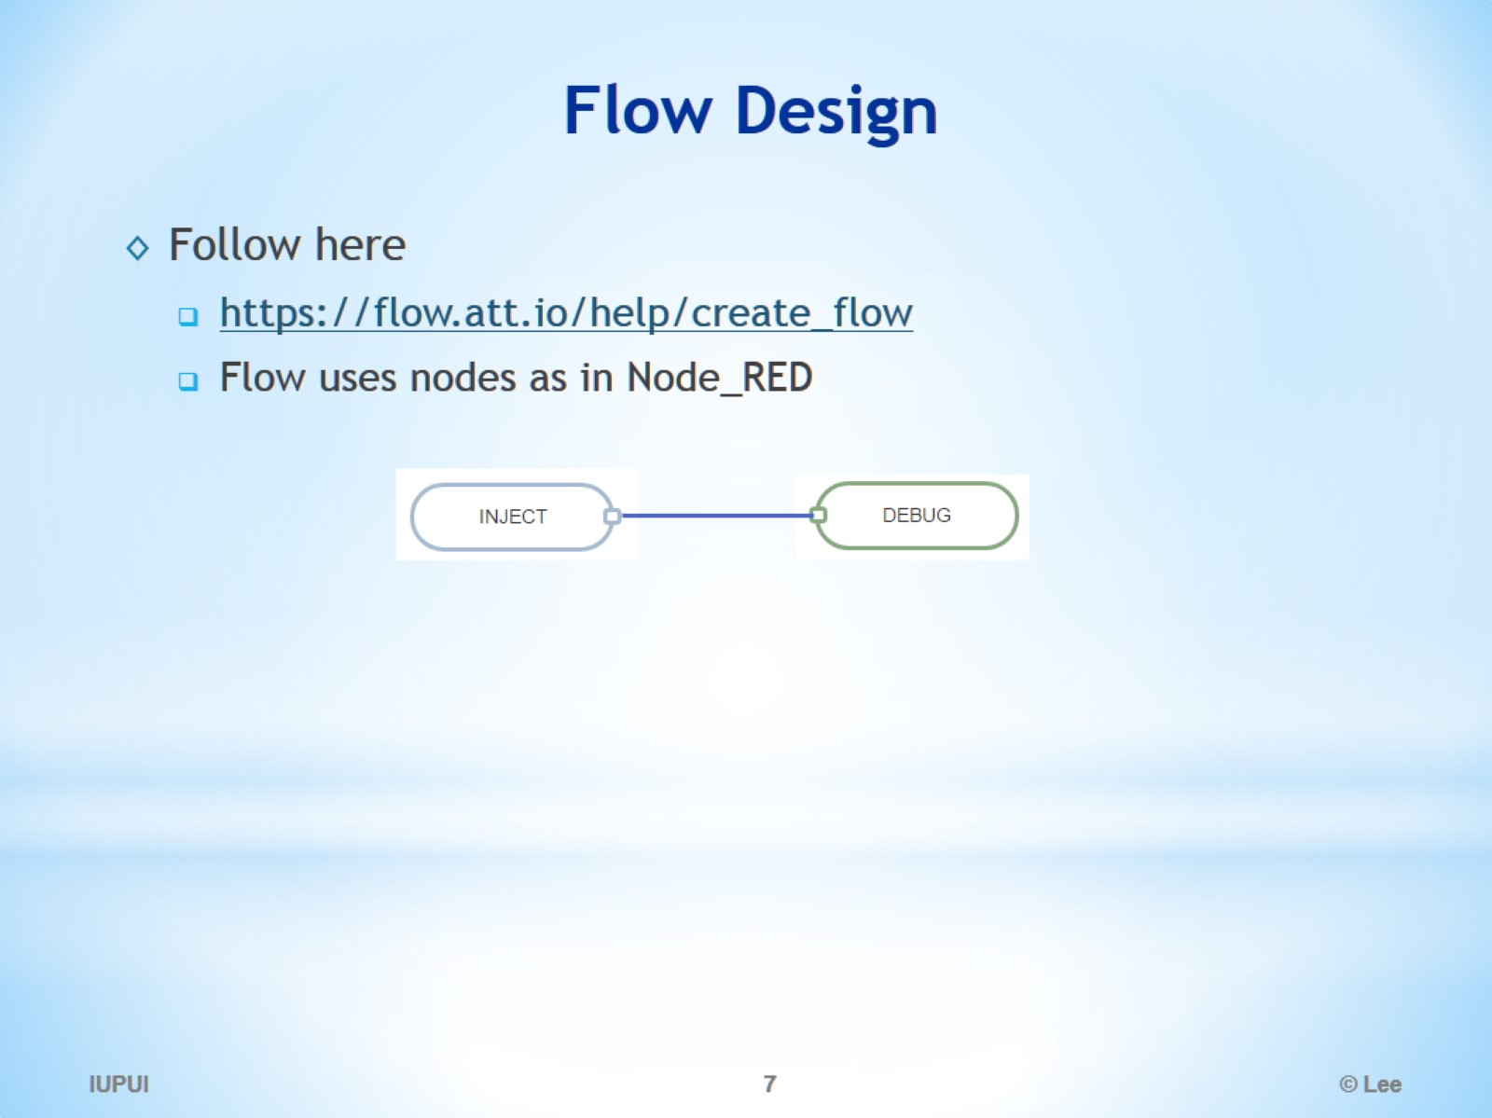
Flow Design

Slide 8
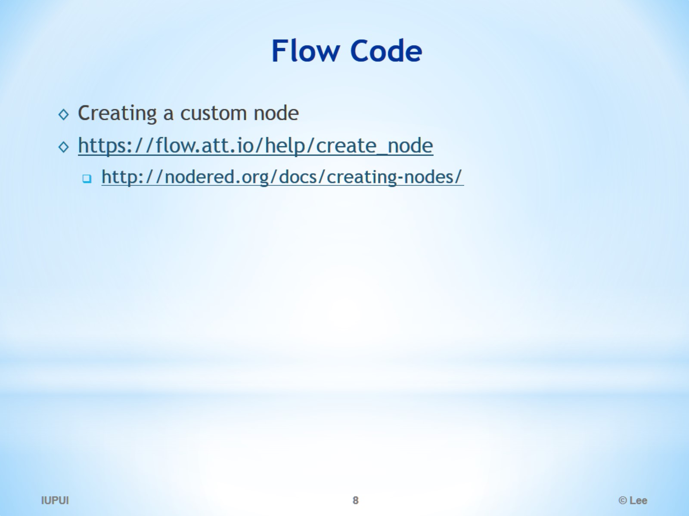
Flow Code

Slide 9
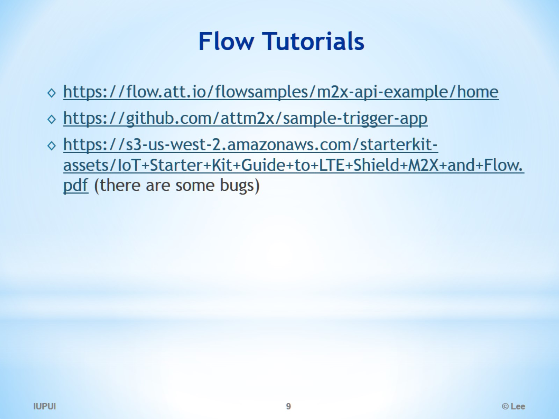
Flow Tutorials

Slide 10
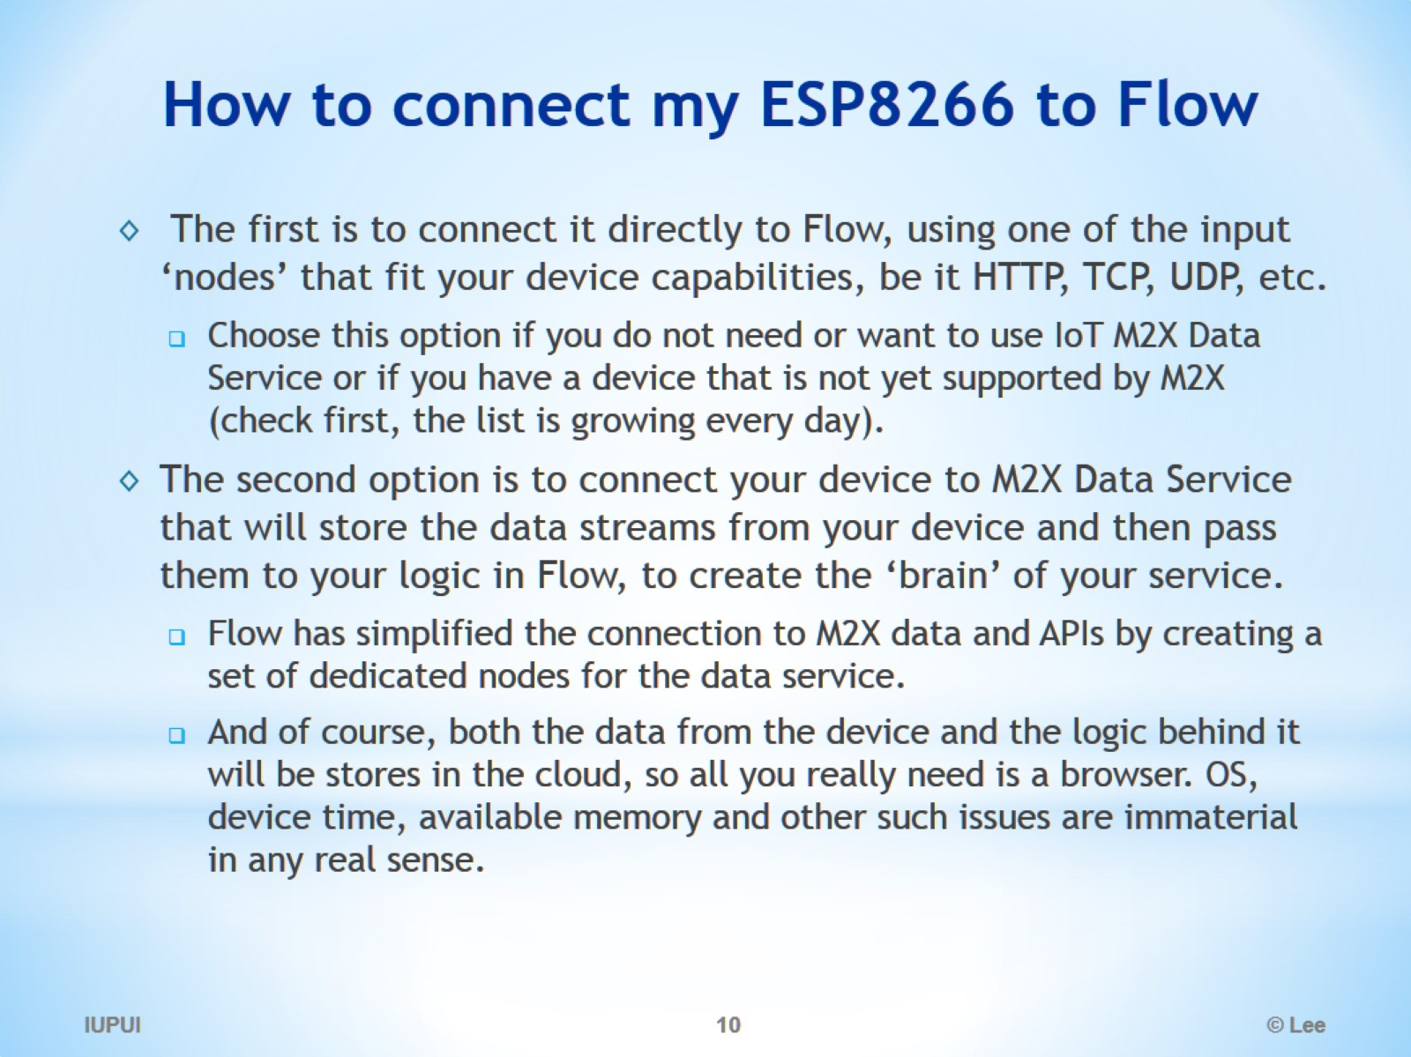
How to connect my ESP8266 to Flow

Slide 11
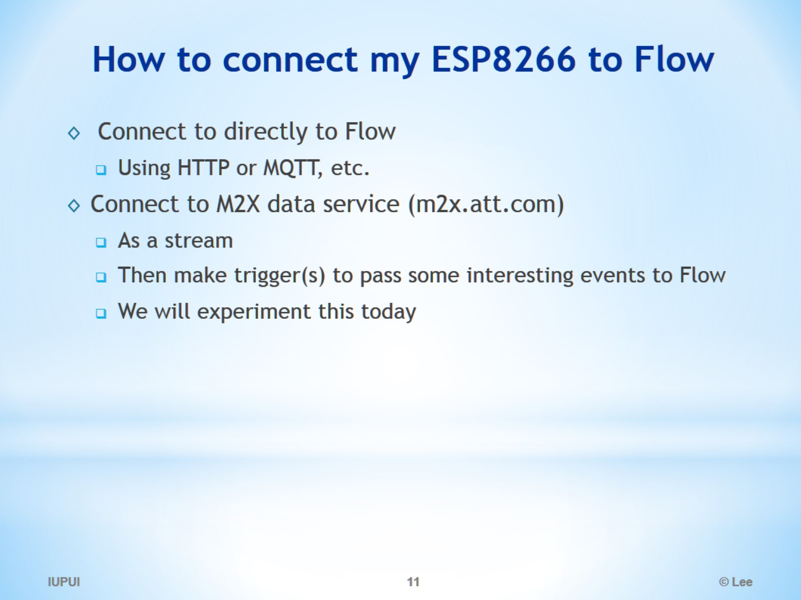
How to connect my ESP8266 to Flow

Slide 12
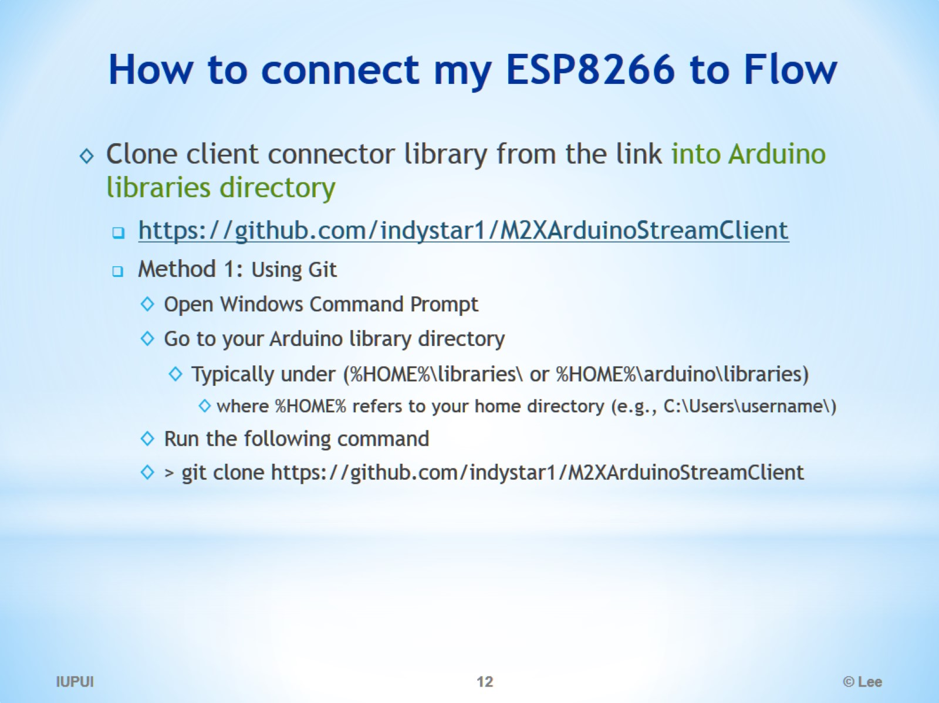
How to connect my ESP8266 to Flow

Slide 13
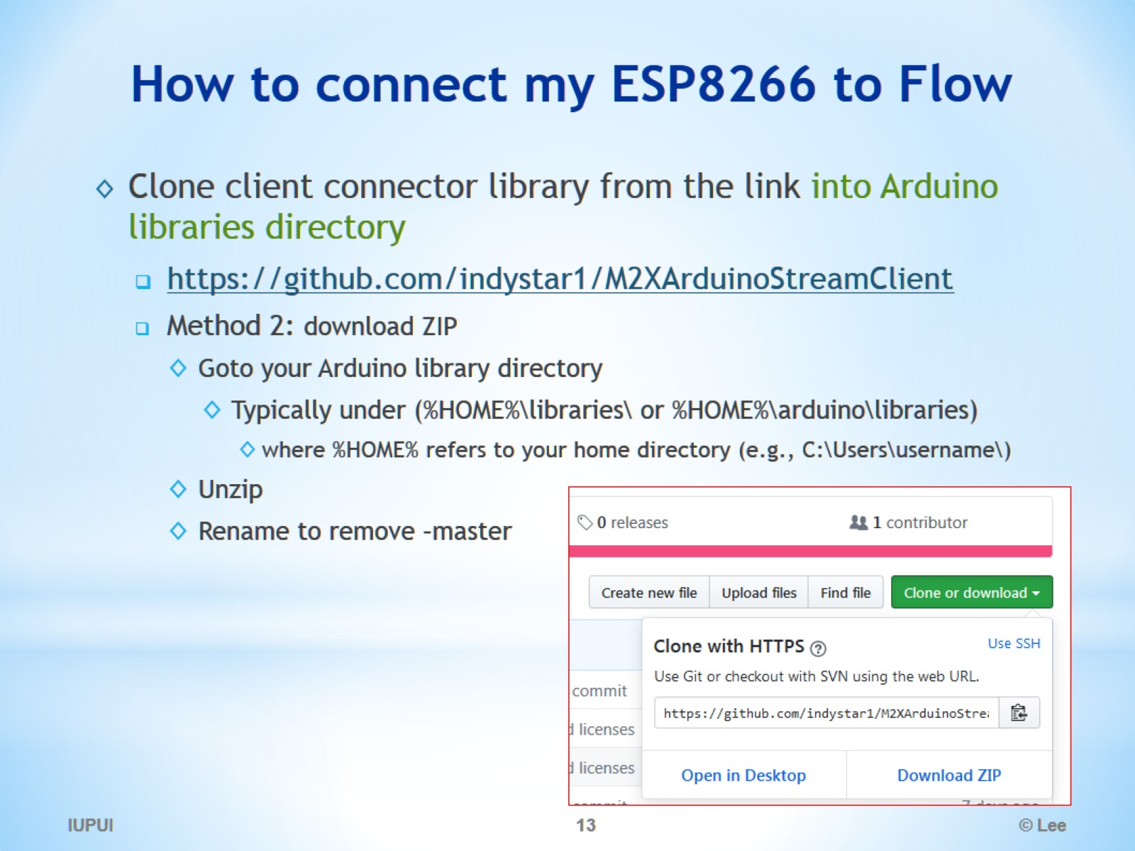
How to connect my ESP8266 to Flow

Slide 14
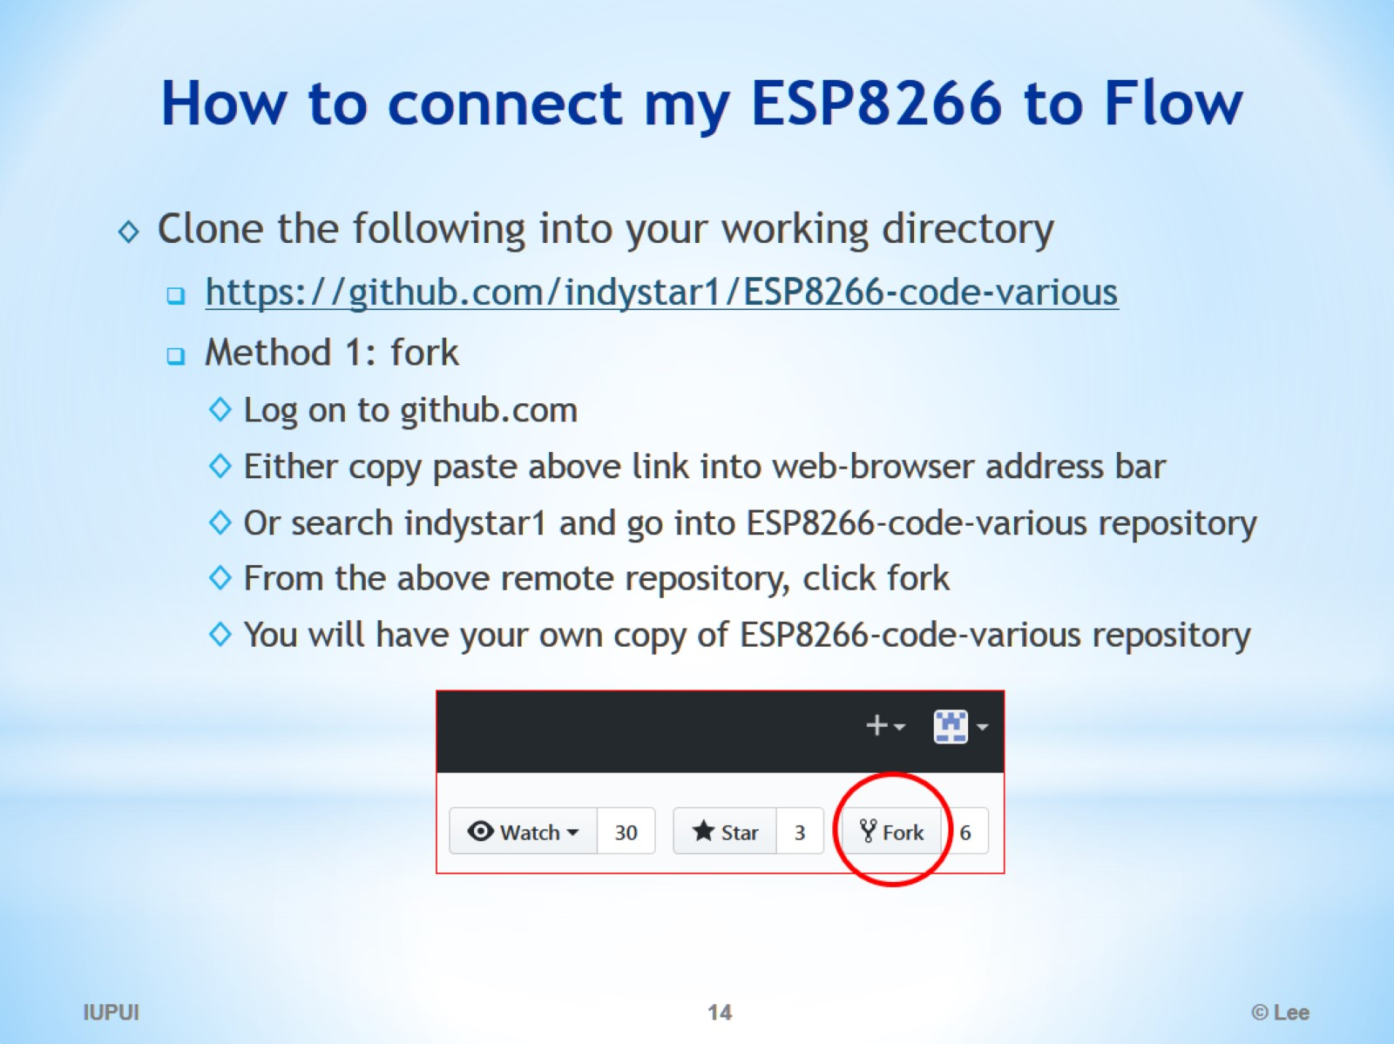
How to connect my ESP8266 to Flow

Slide 15
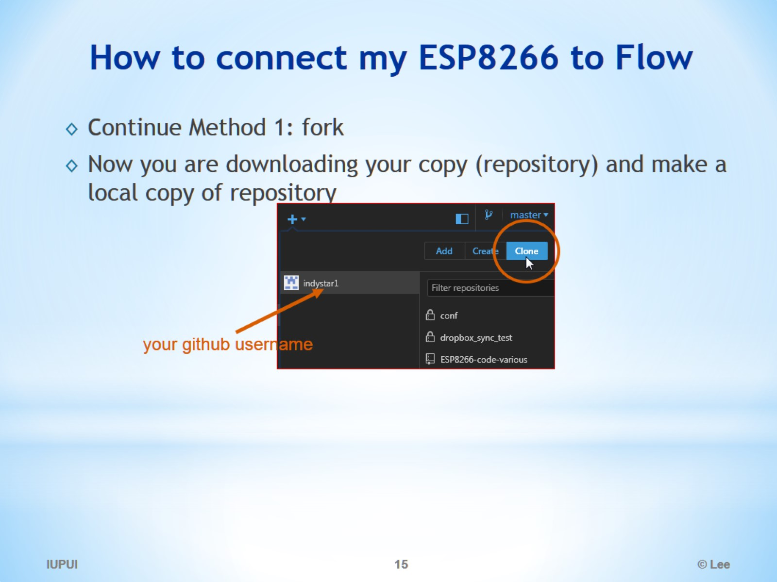
How to connect my ESP8266 to Flow

Slide 16
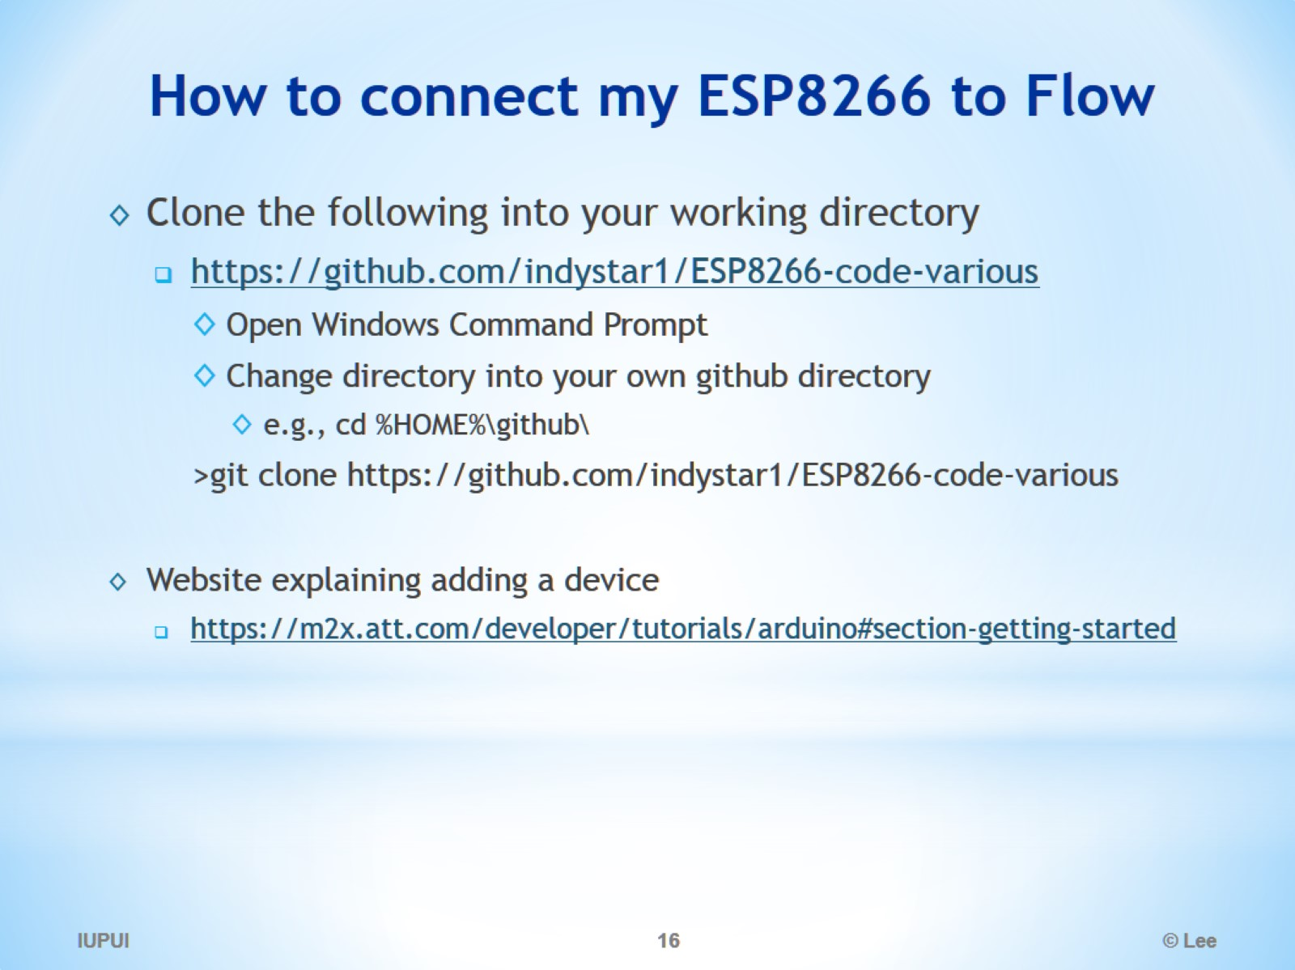
How to connect my ESP8266 to Flow

Slide 17
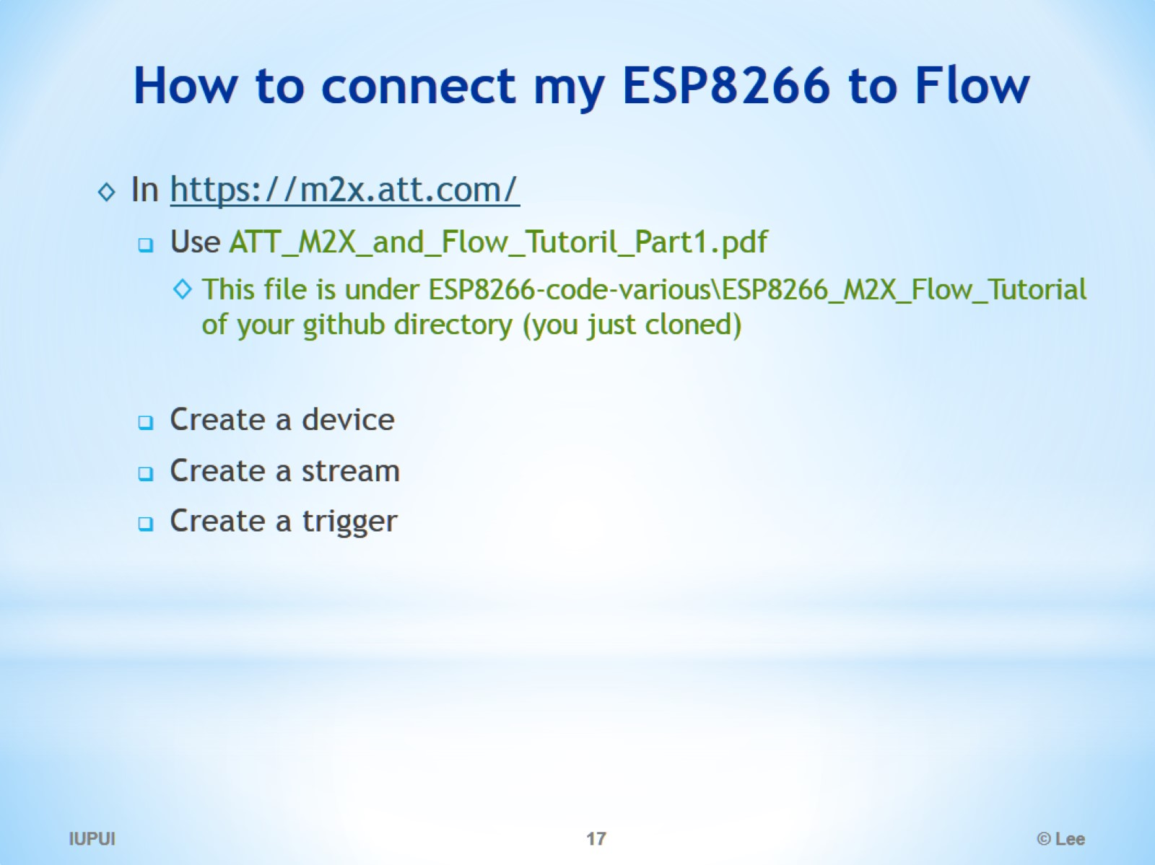
How to connect my ESP8266 to Flow

Slide 18
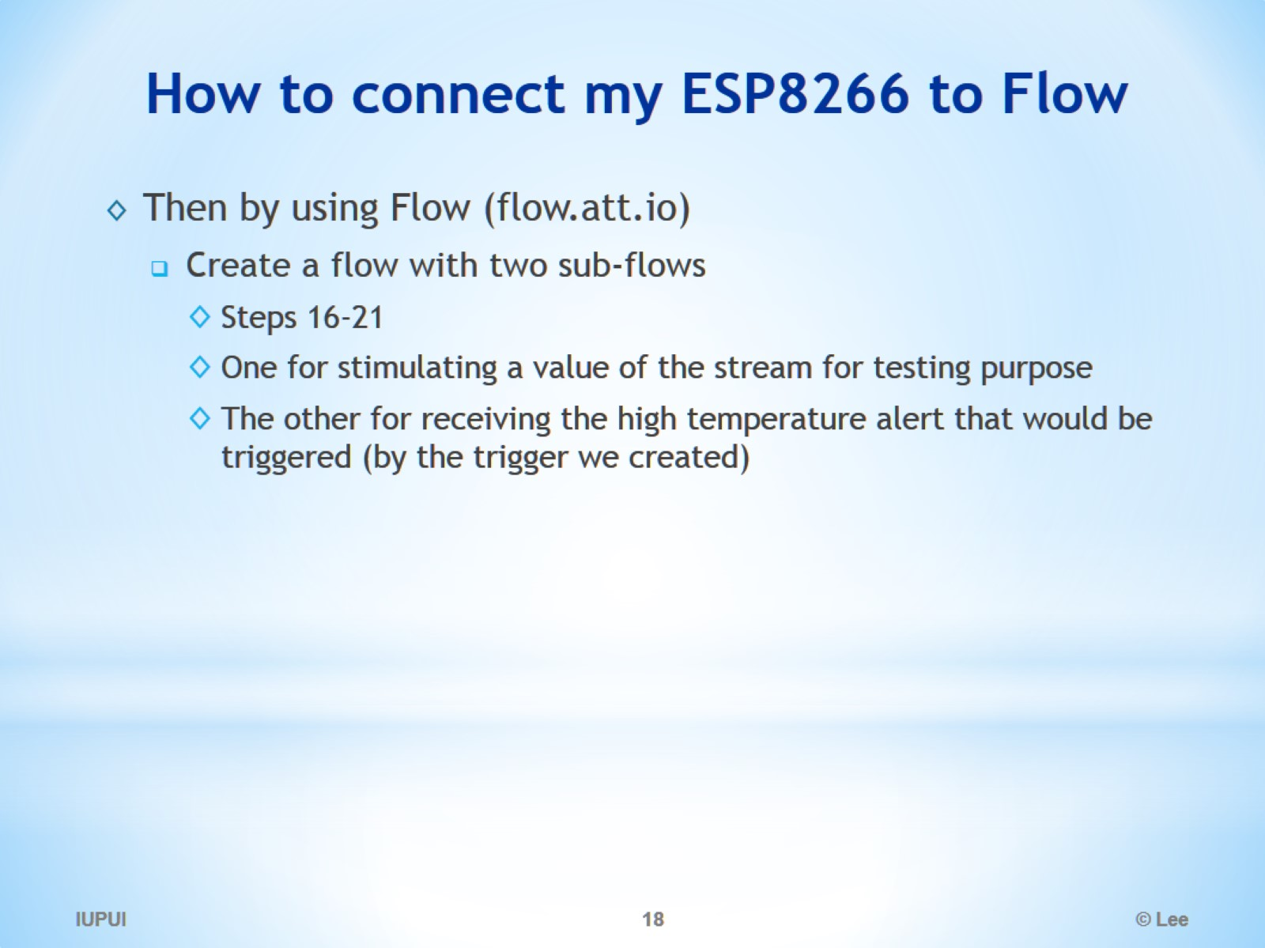
How to connect my ESP8266 to Flow

Slide 19
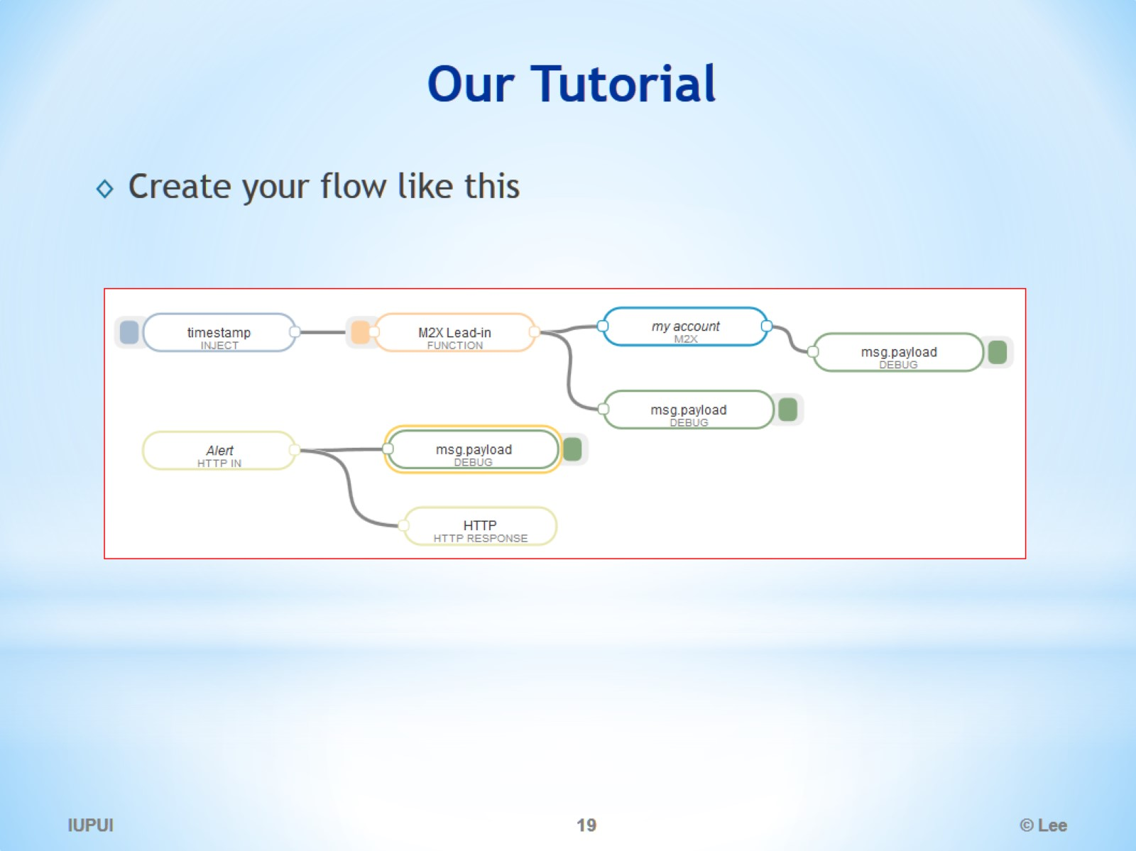
Our Tutorial

Slide 20
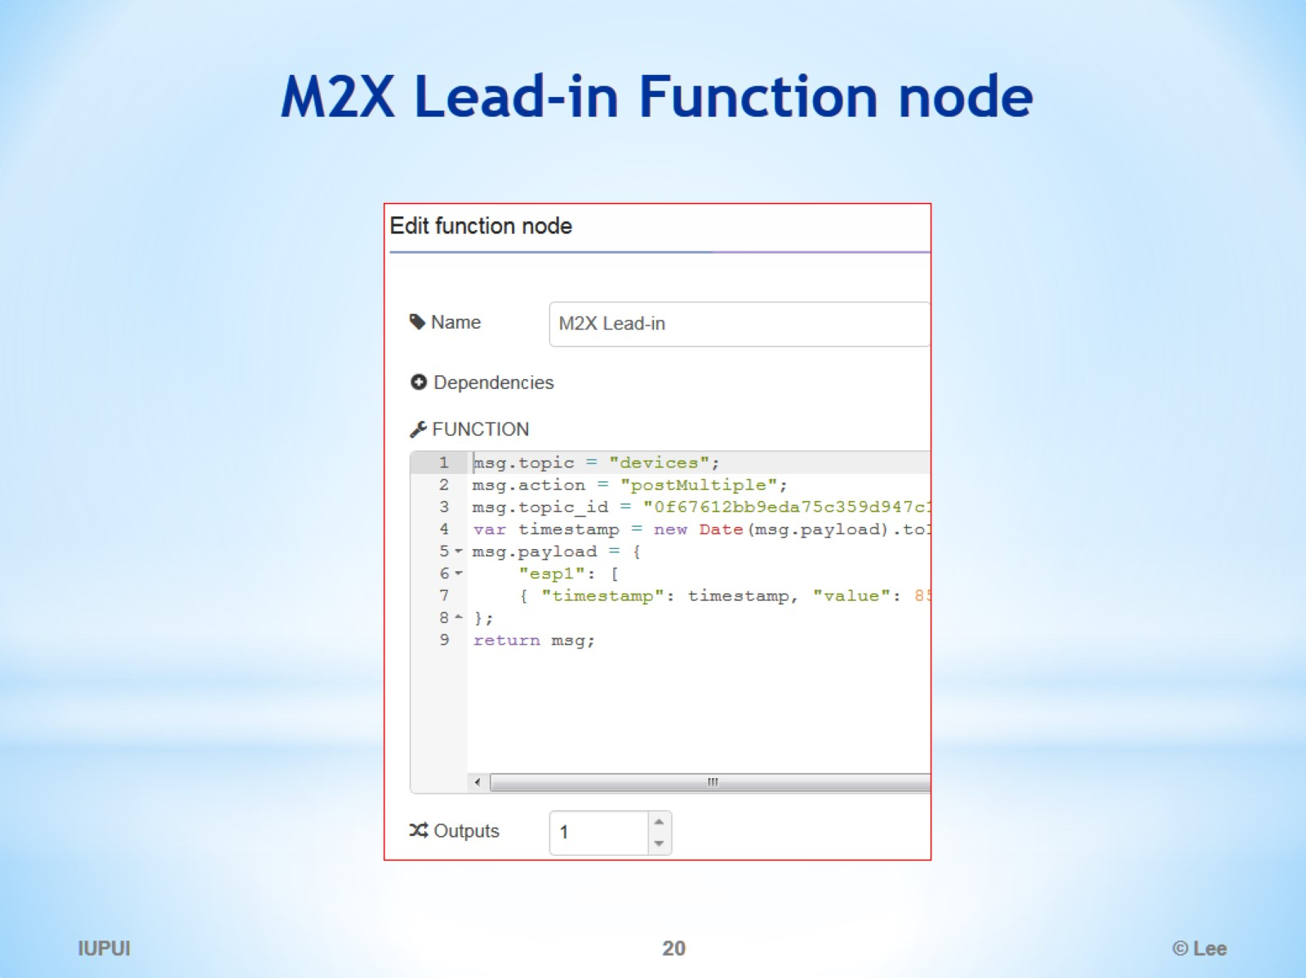
M2X Lead-in Function node

Slide 21
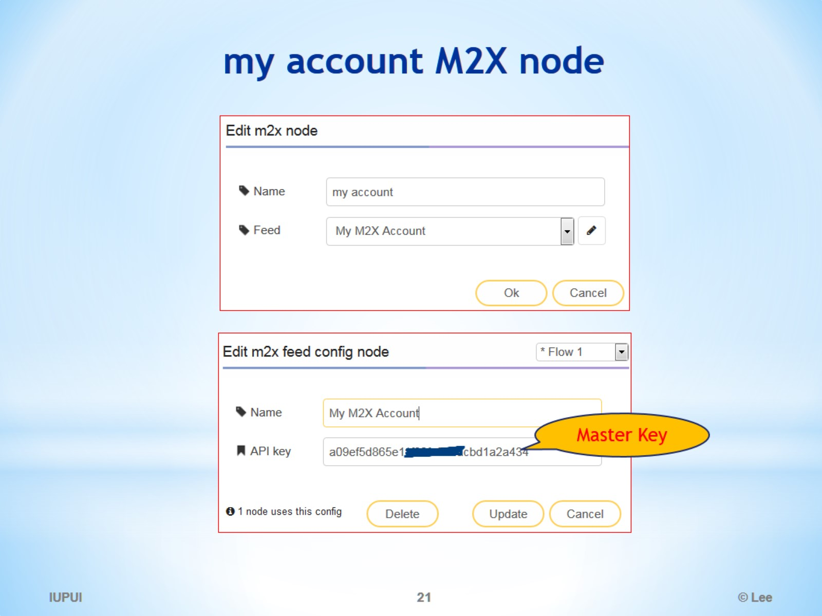
my account M2X node

Slide 22
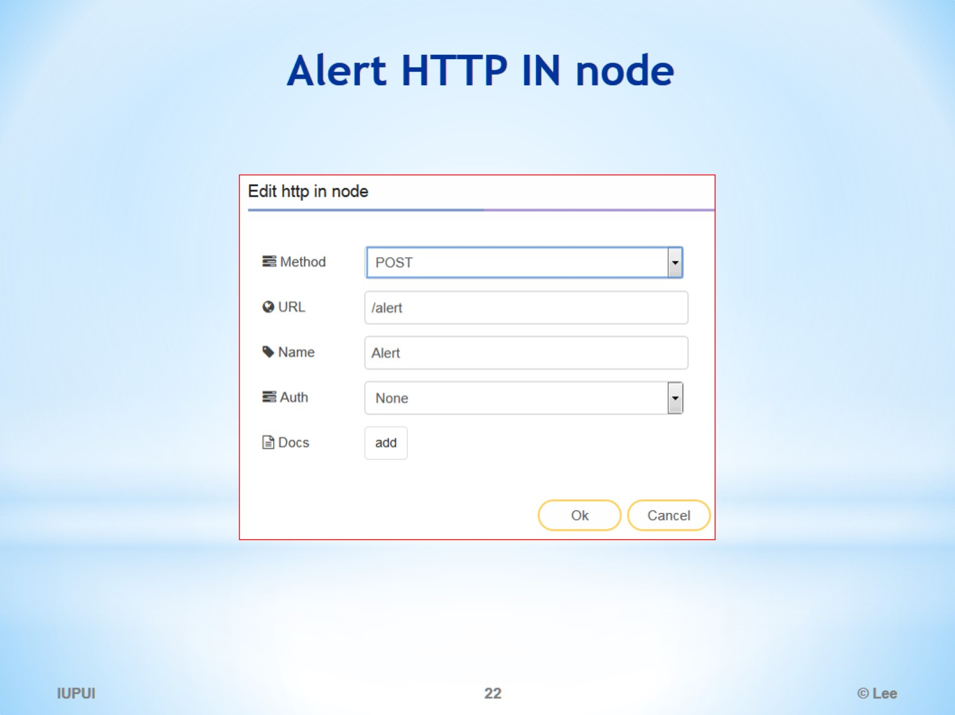
Alert HTTP IN node

Slide 23
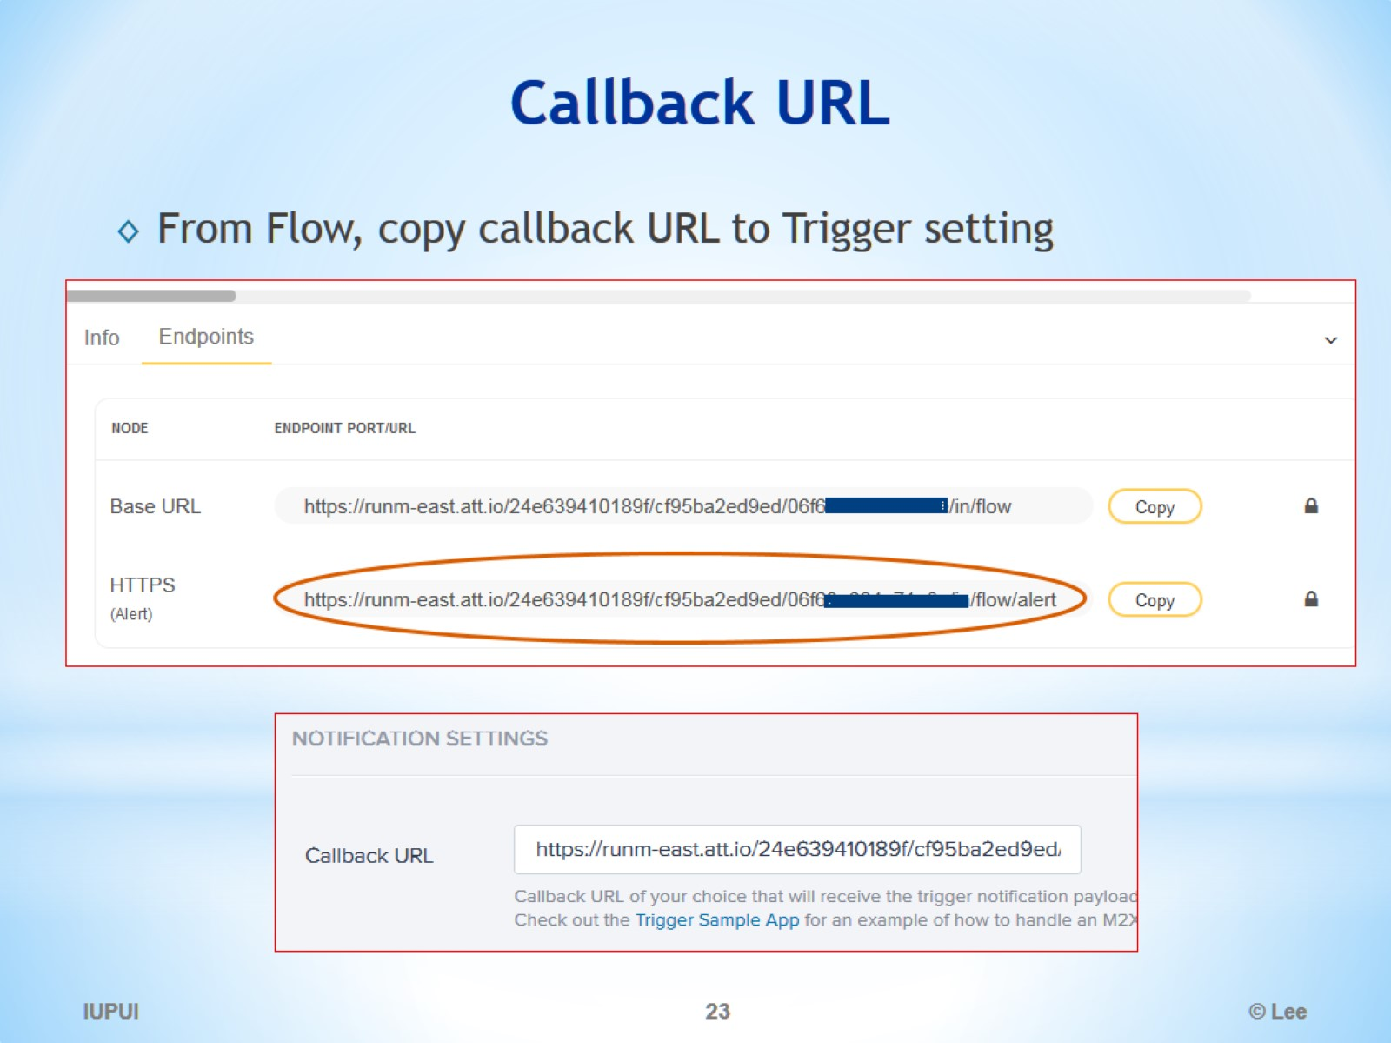
Callback URL

Slide 24
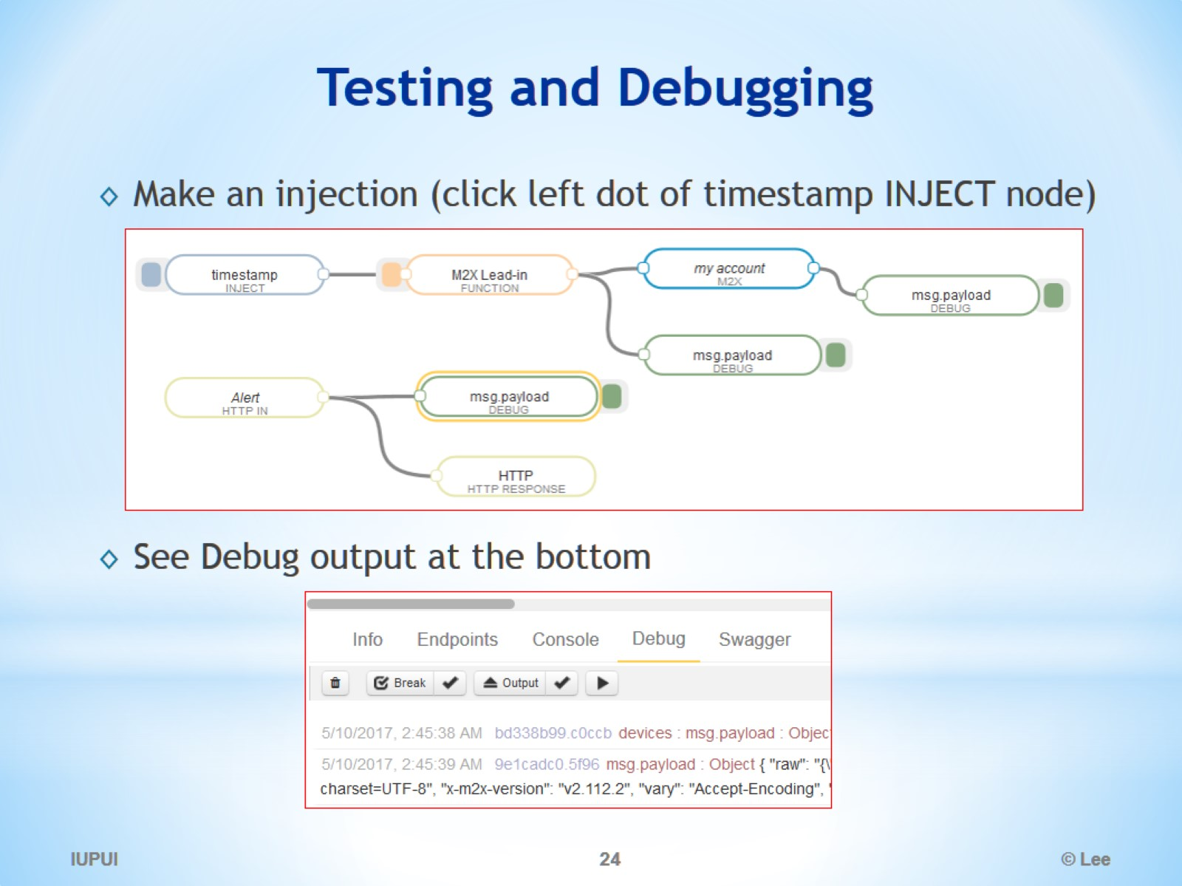
Testing and Debugging

Slide 25
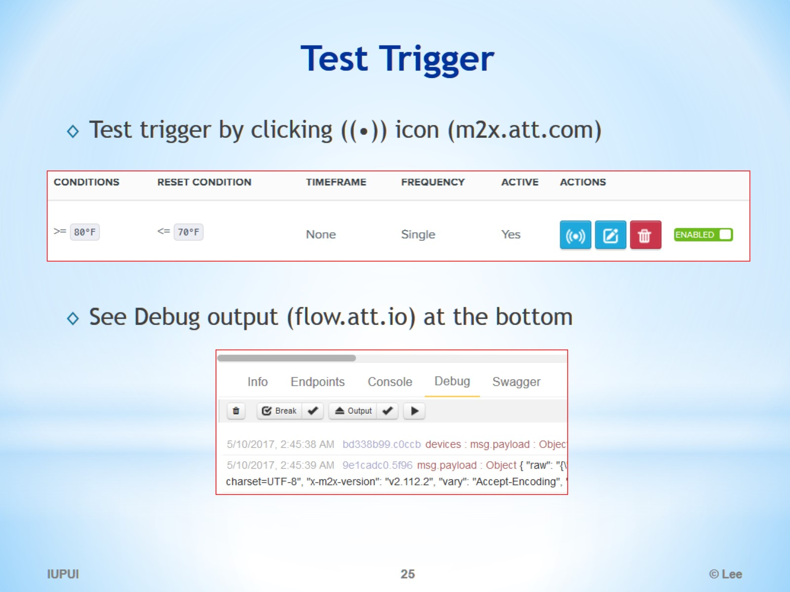
Test Trigger

Slide 26
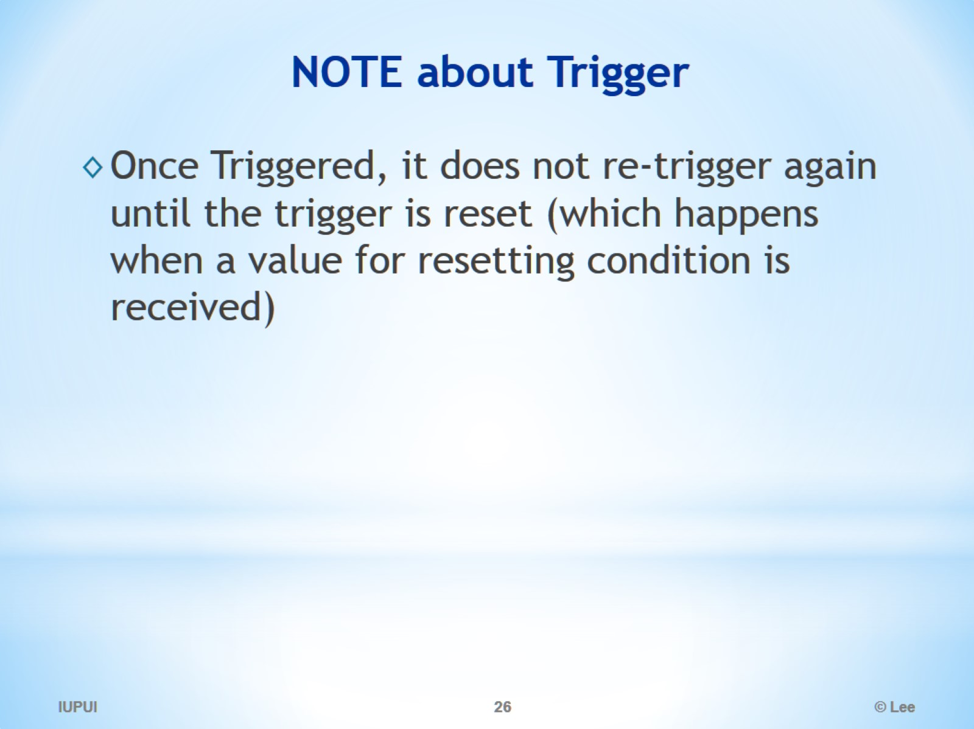
NOTE about Trigger

Slide 27
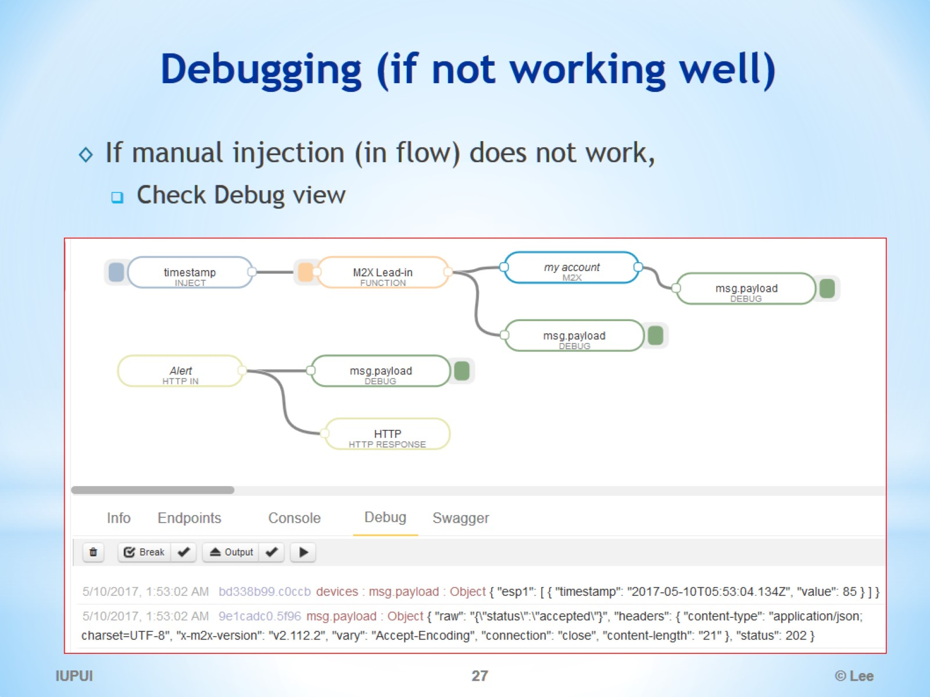
Debugging (if not working well)

Slide 28
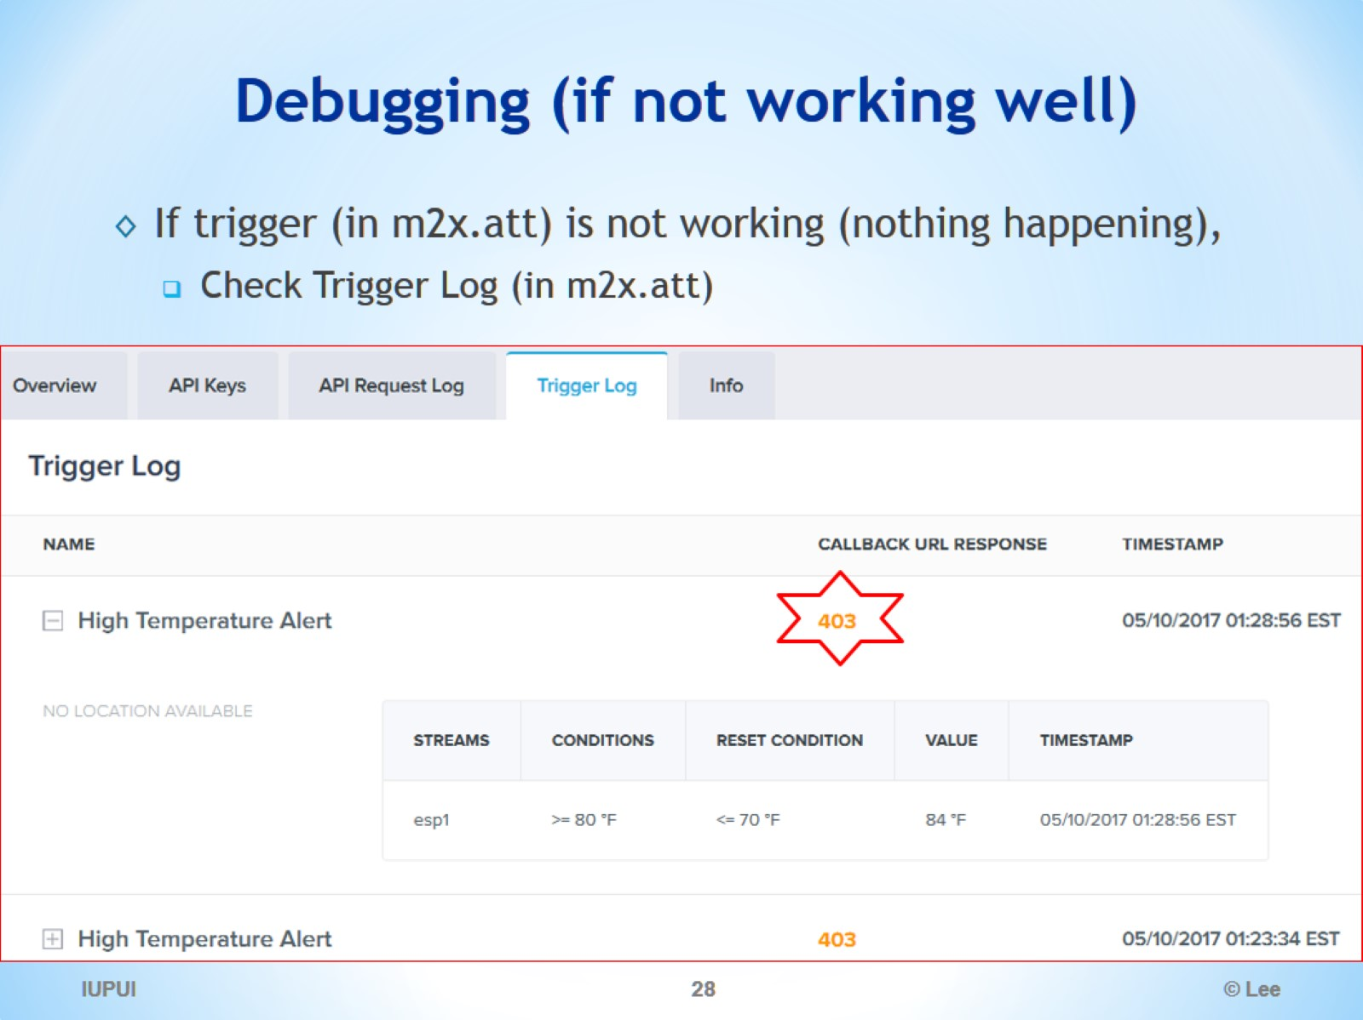
Debugging (if not working well)

Slide 29
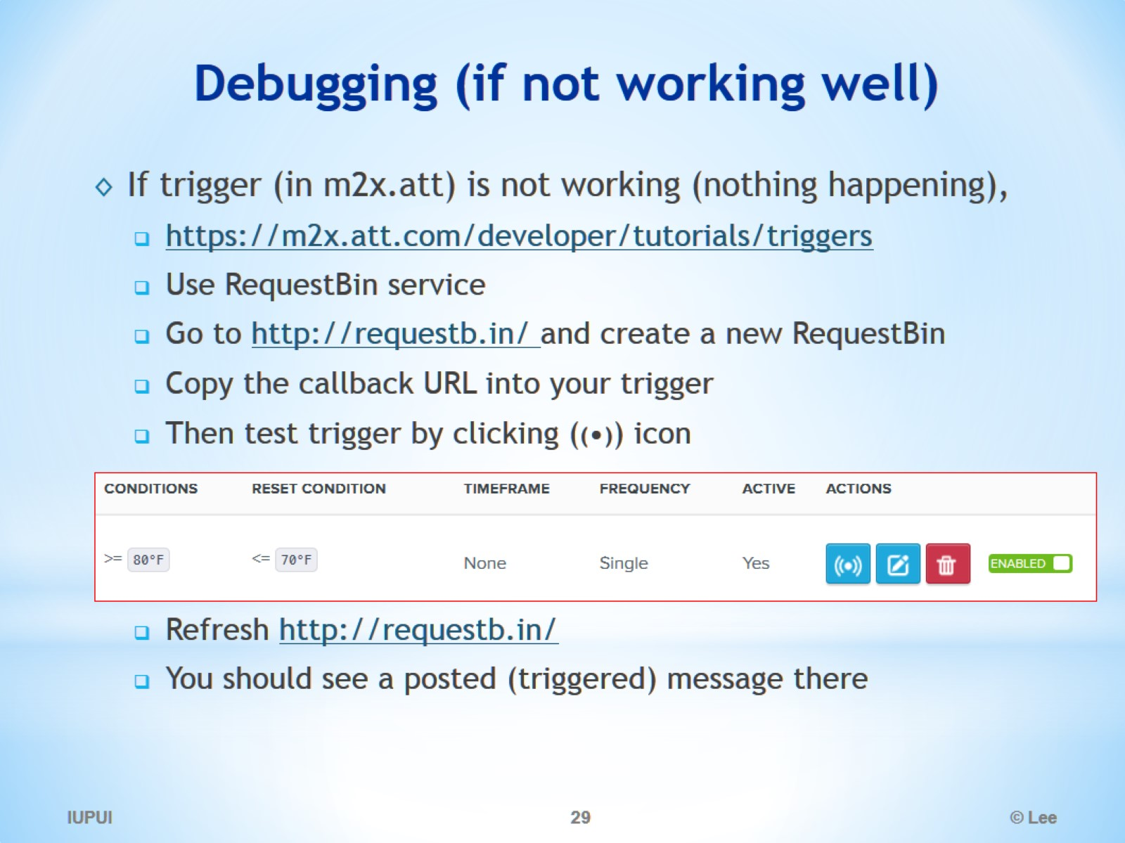
Debugging (if not working well)

Slide 30
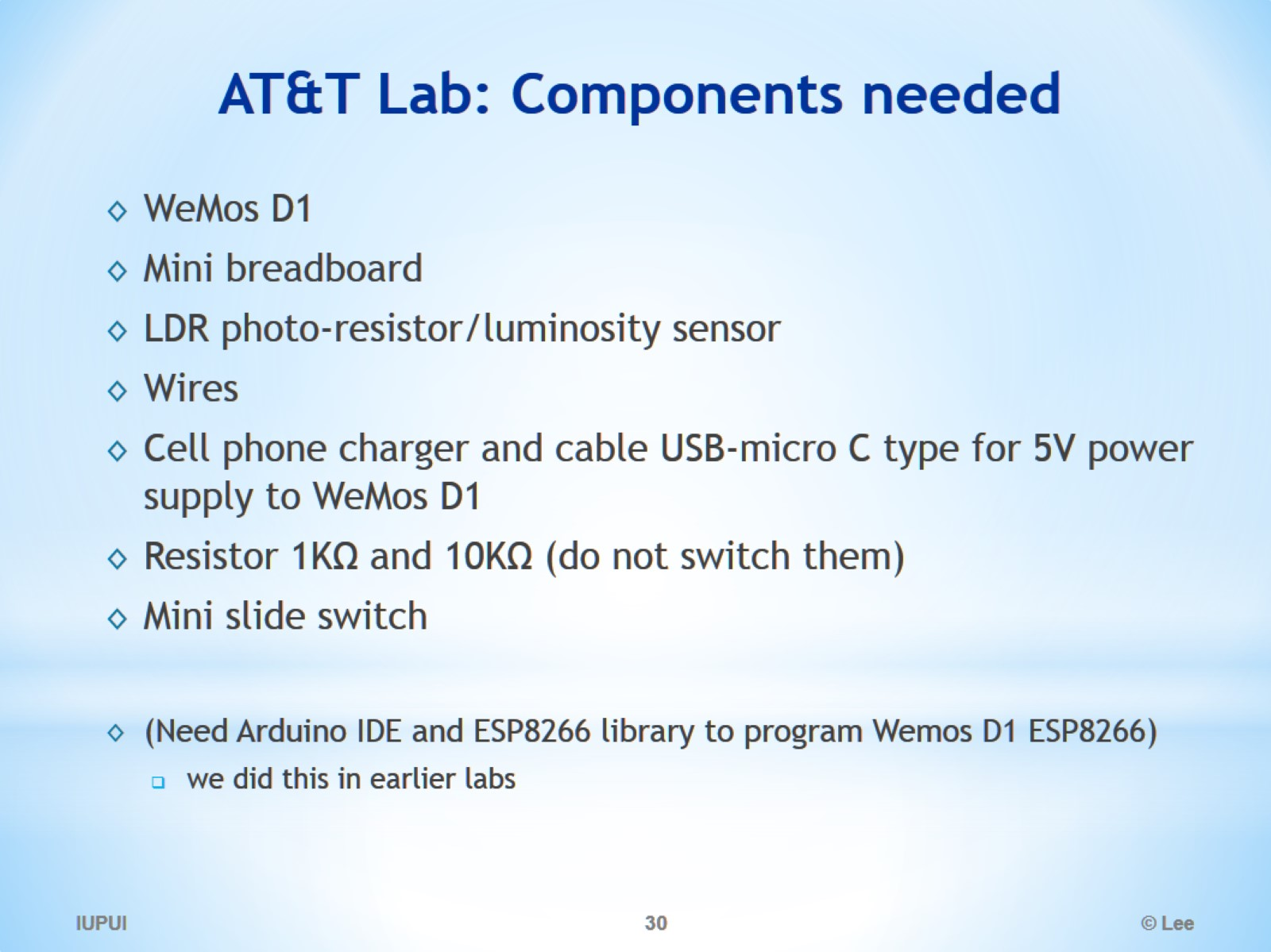
AT&T Lab: Components needed

Slide 31
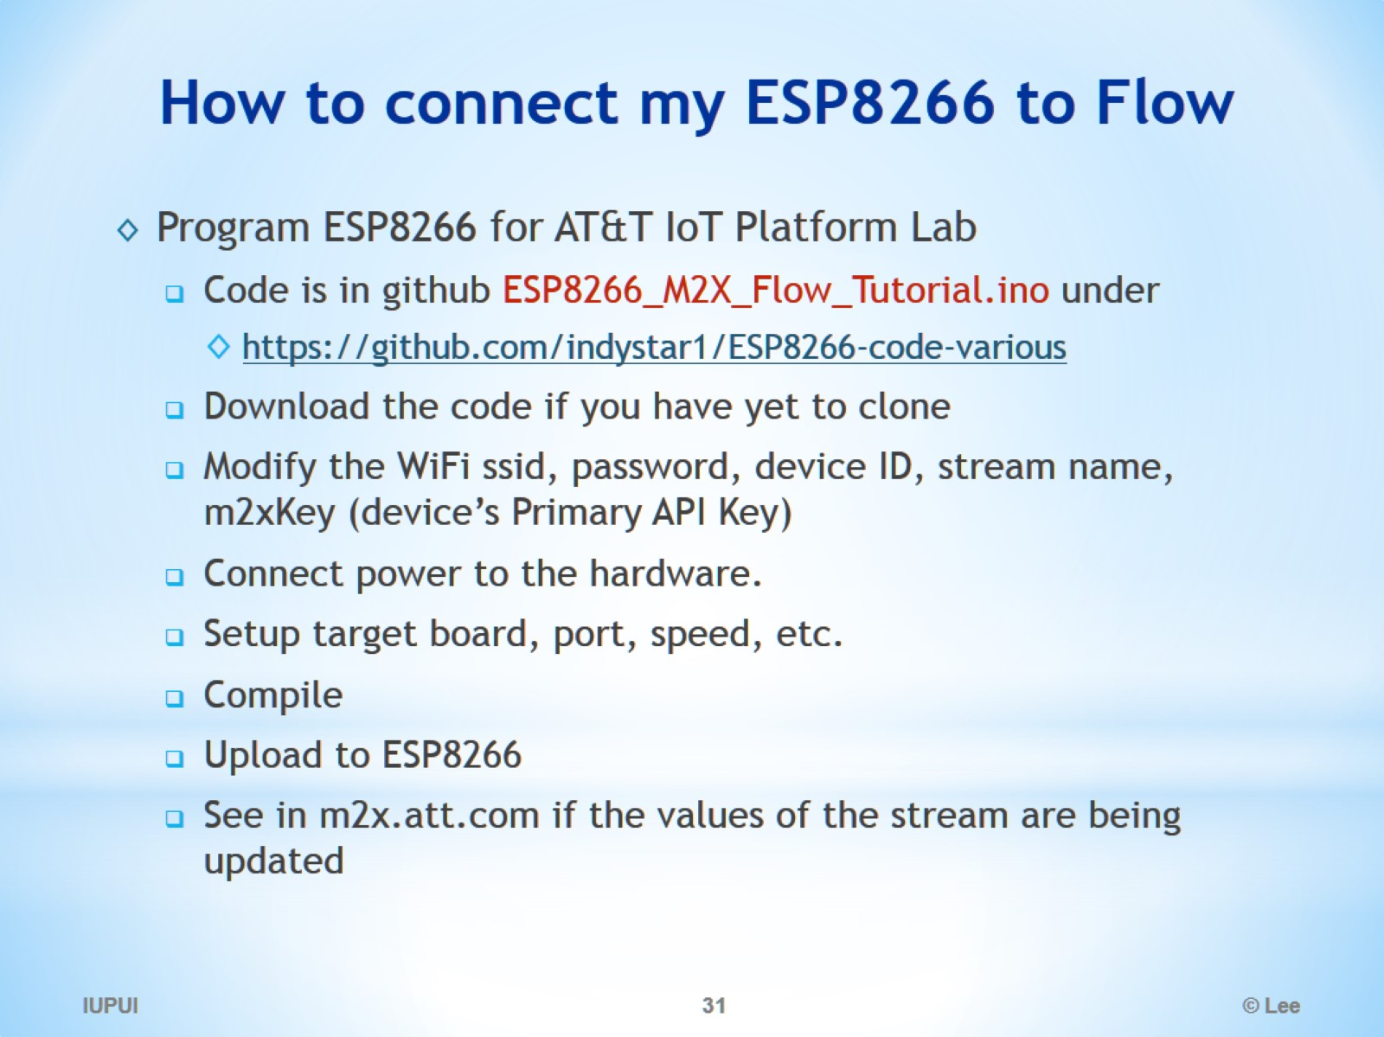
How to connect my ESP8266 to Flow

Slide 32
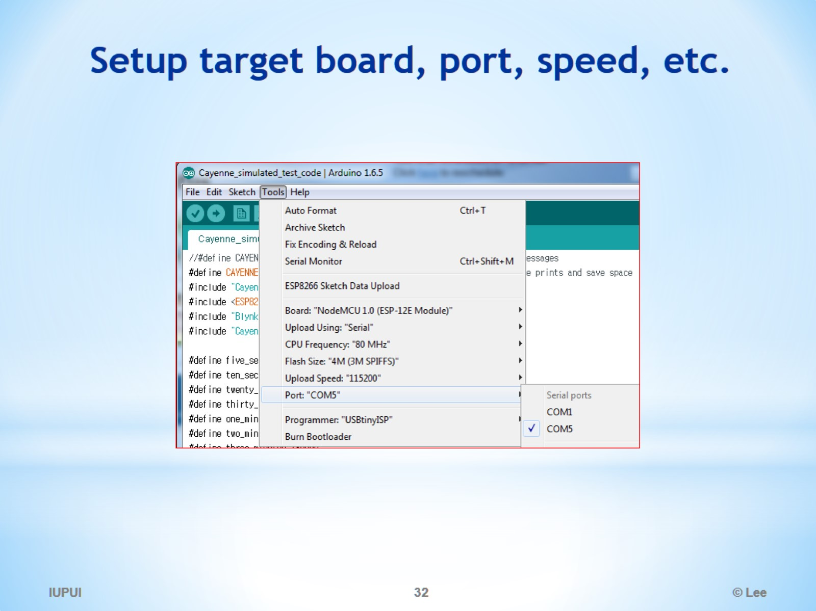
Setup target board, port, speed, etc.

Slide 33
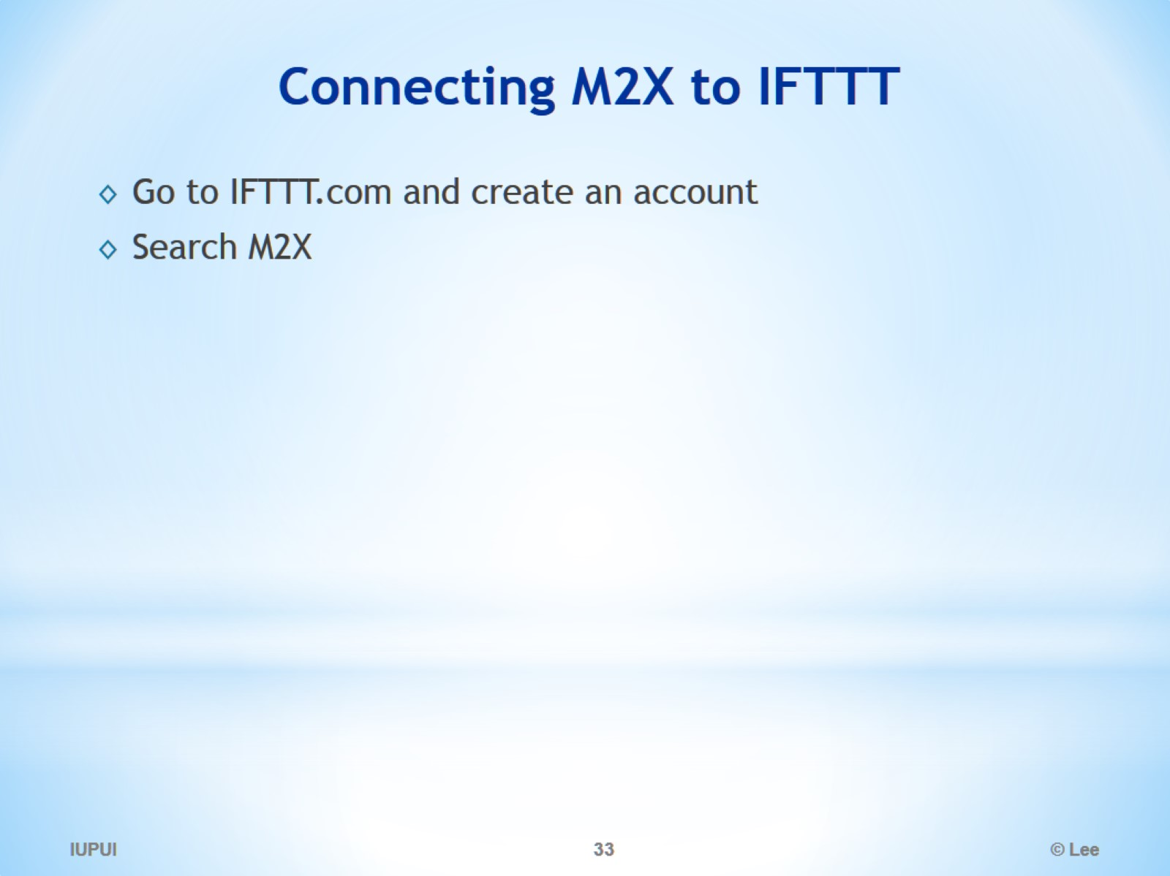
Connecting M2X to IFTTT

Slide 34
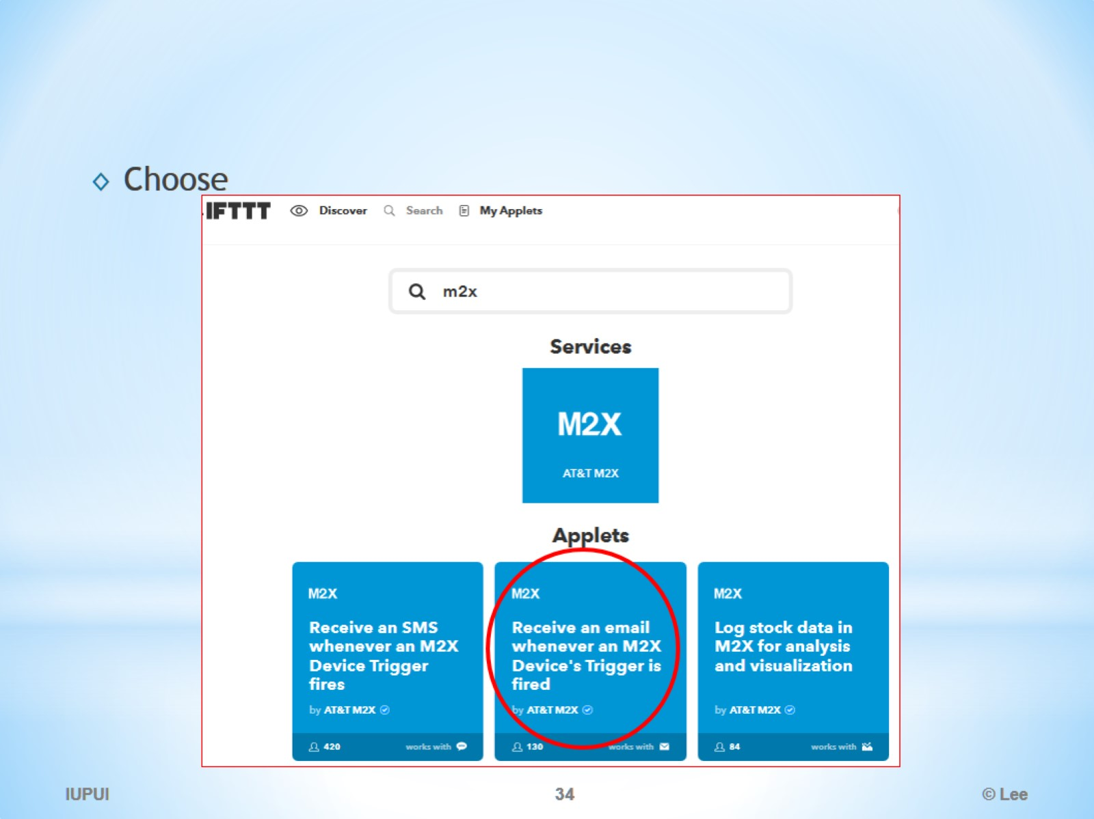

Slide 35
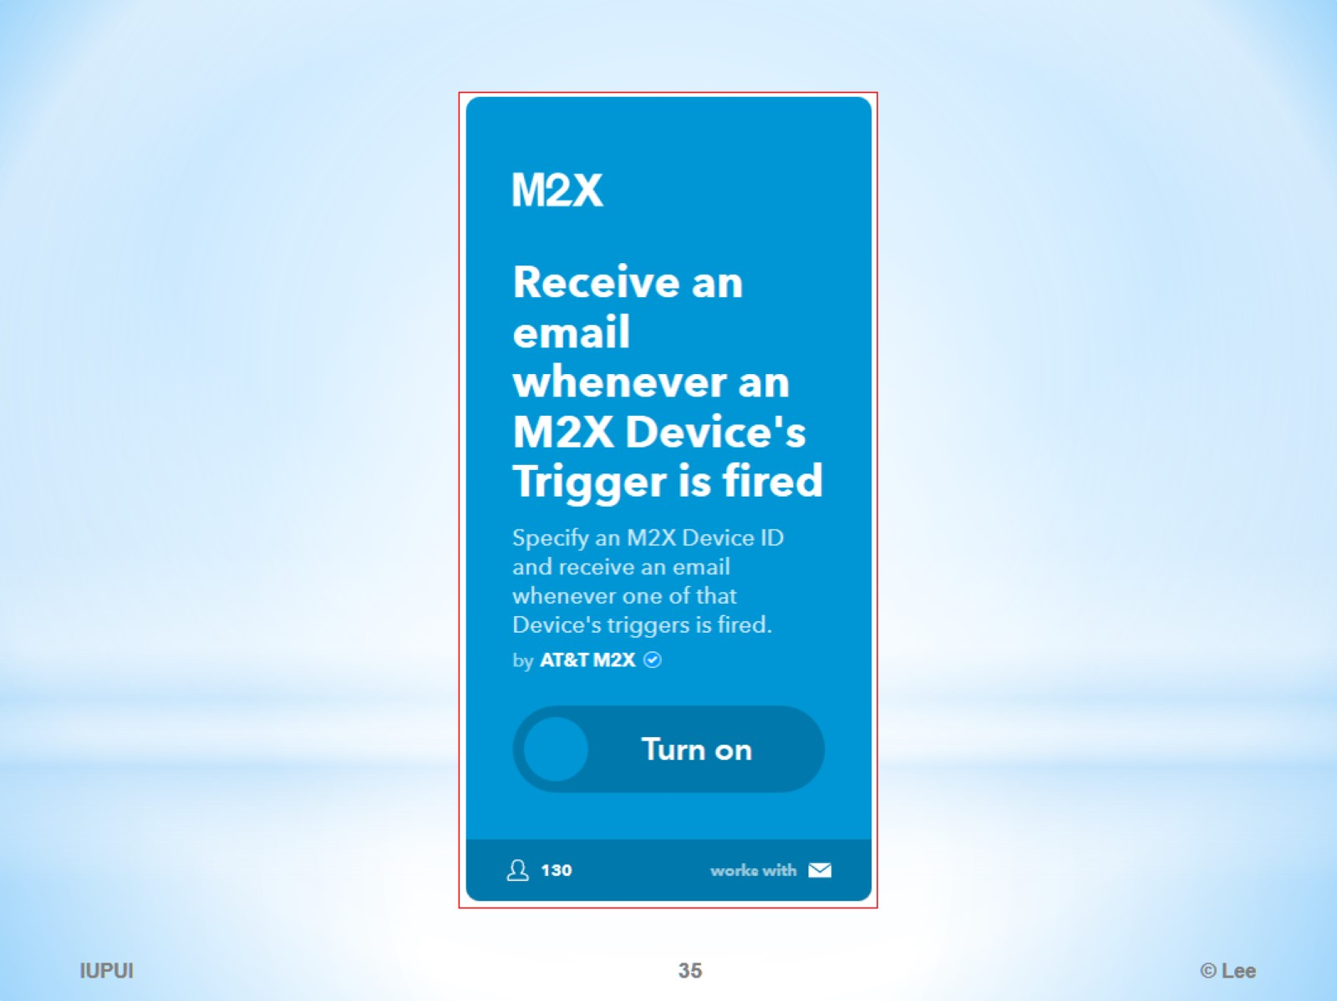

Slide 36
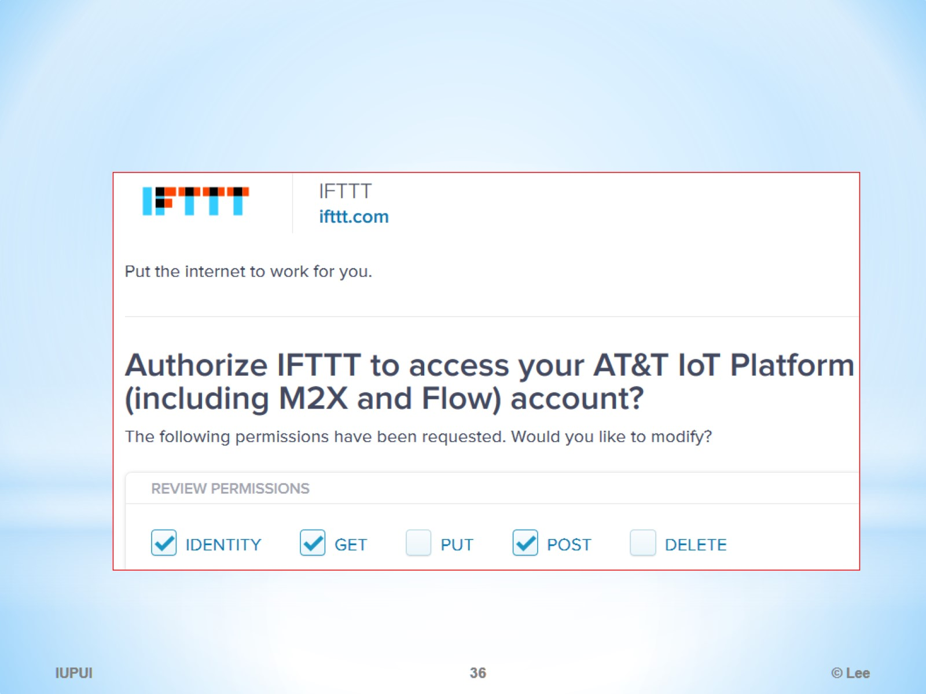

Slide 37
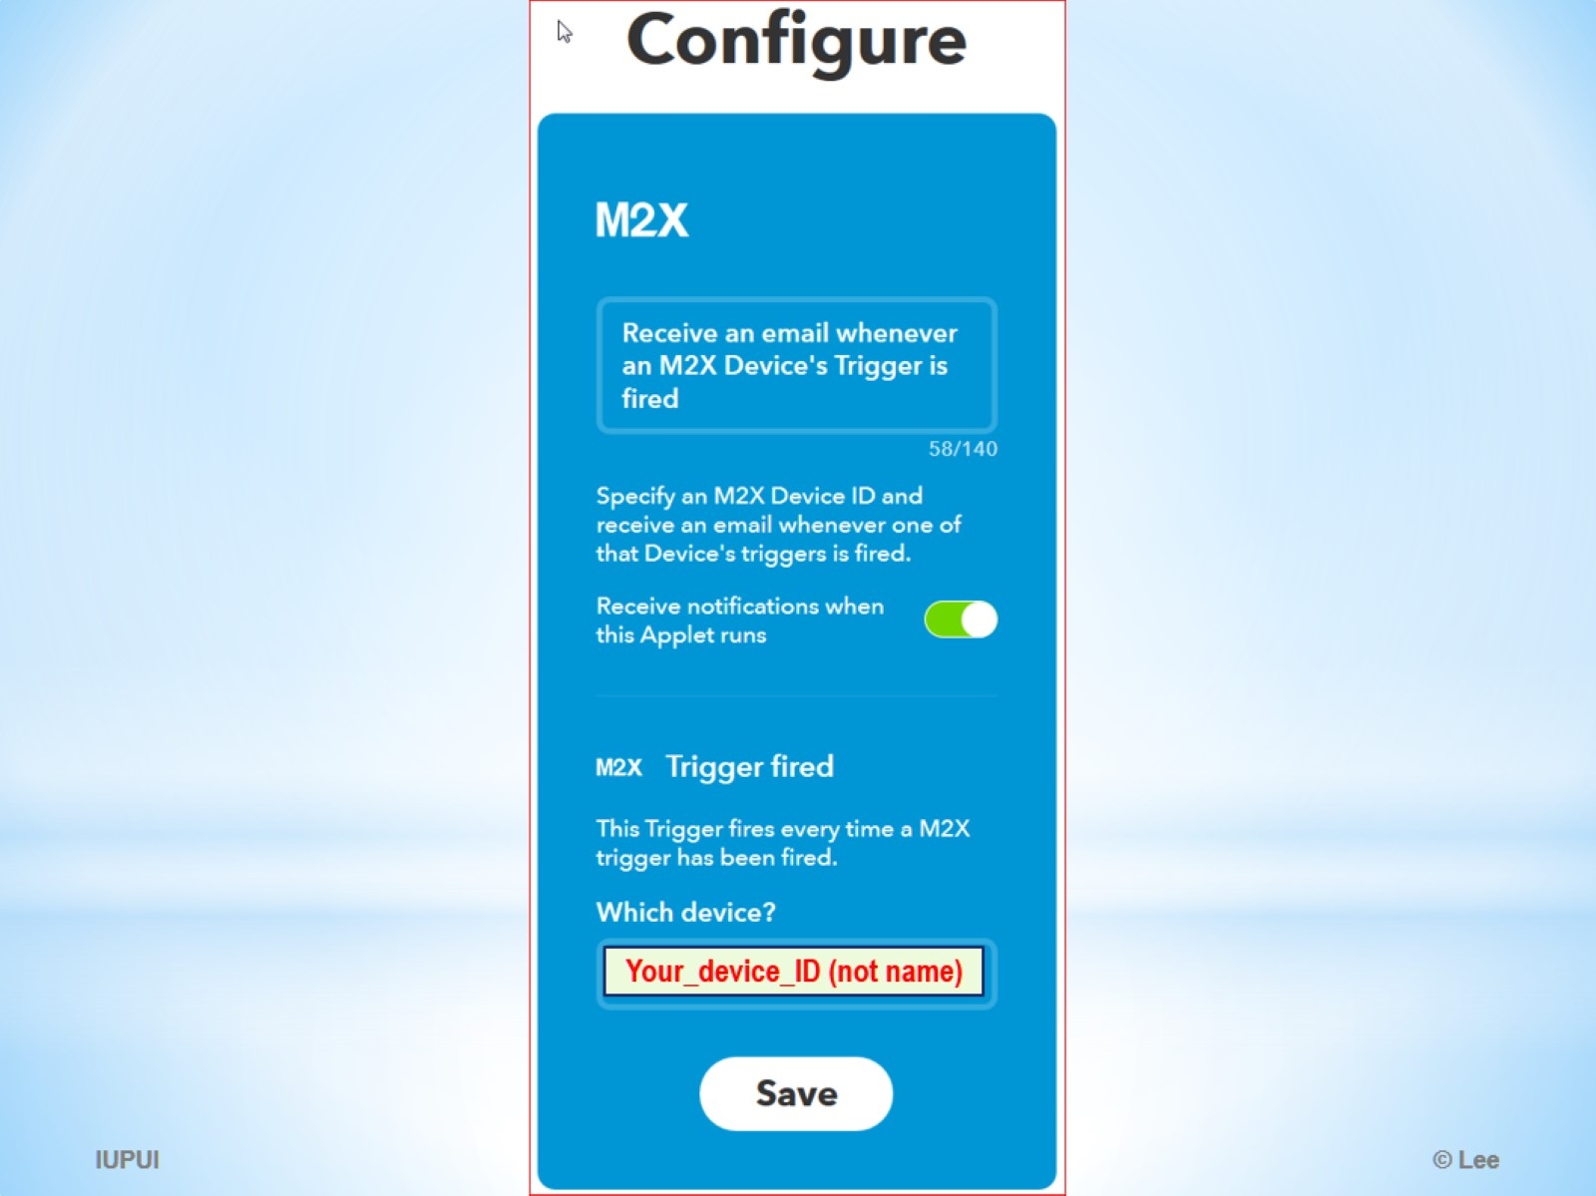

Slide 38
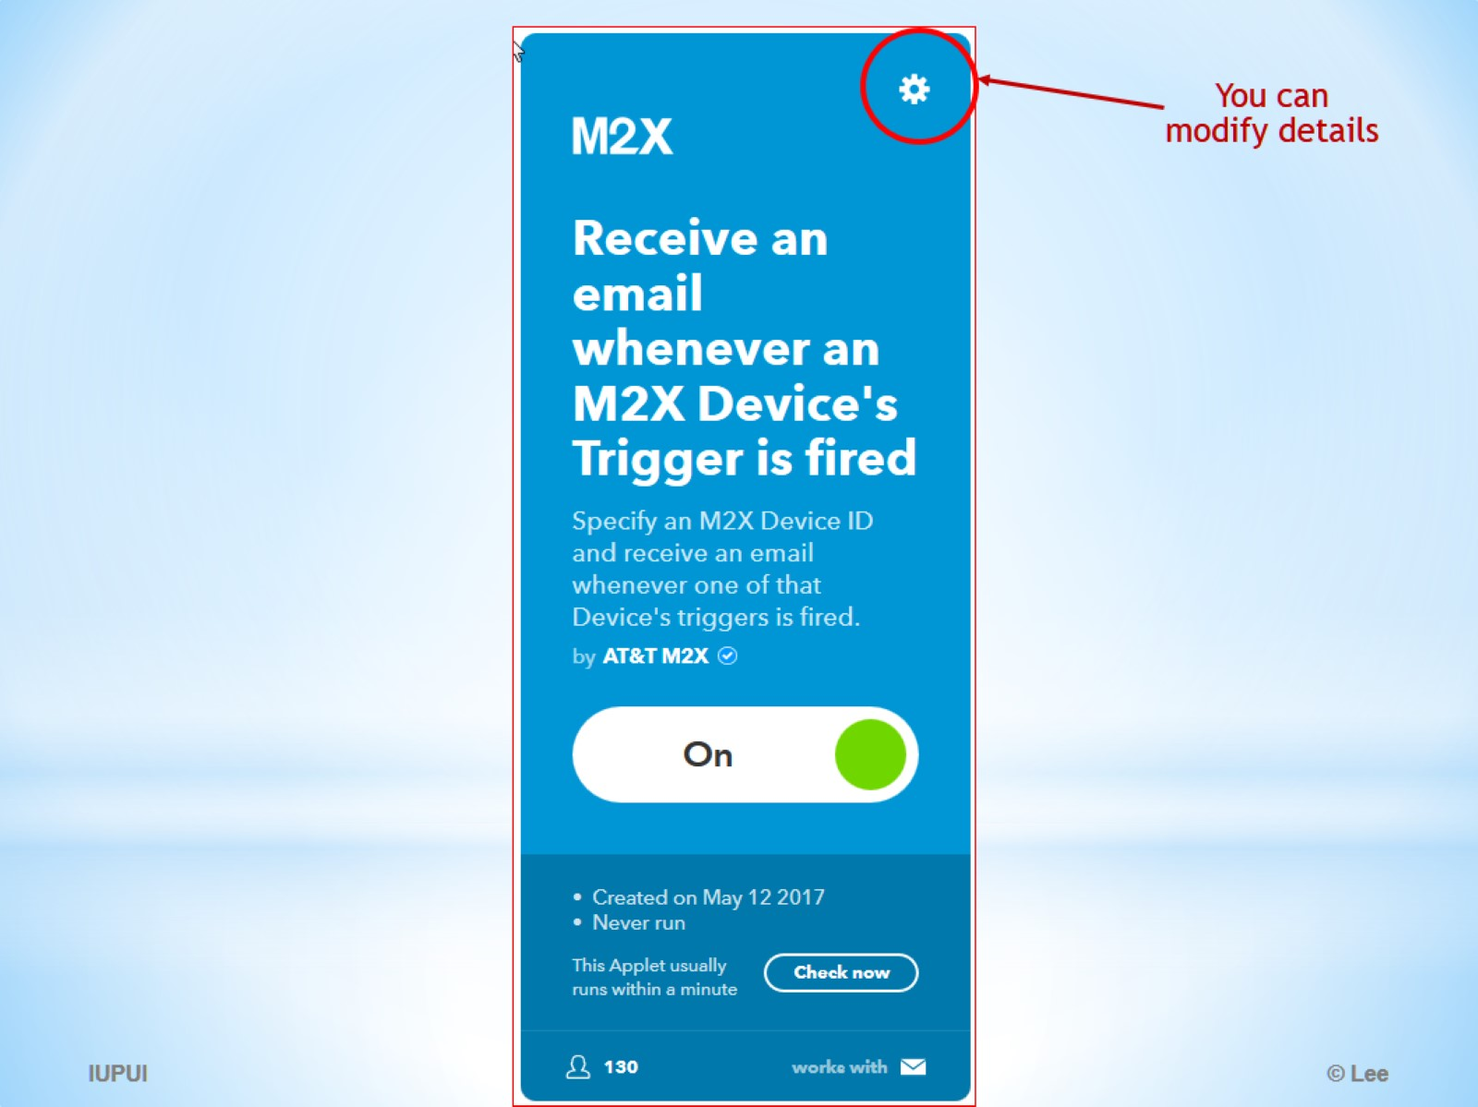

Slide 39
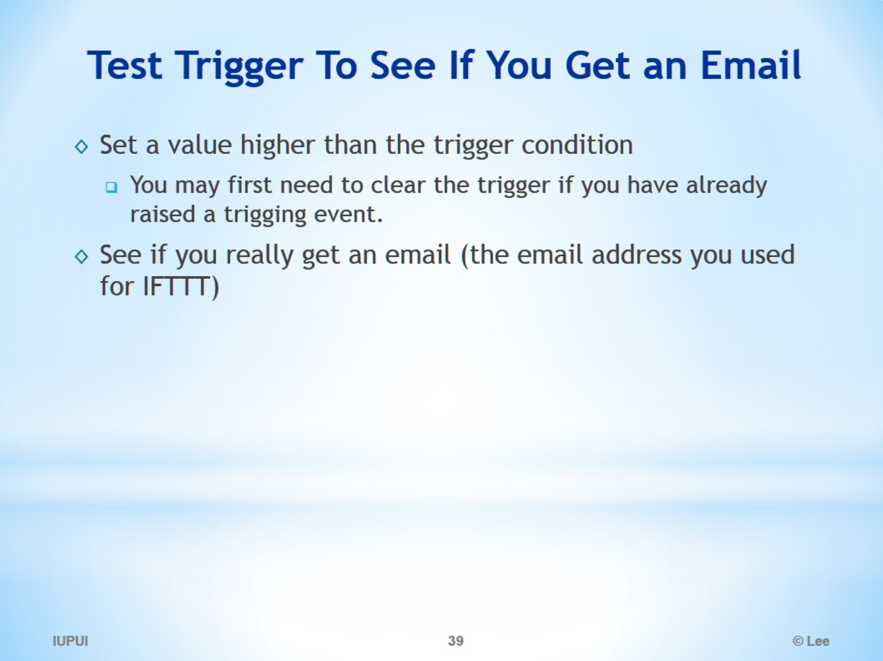
Test Trigger To See If You Get an Email

Slide 40
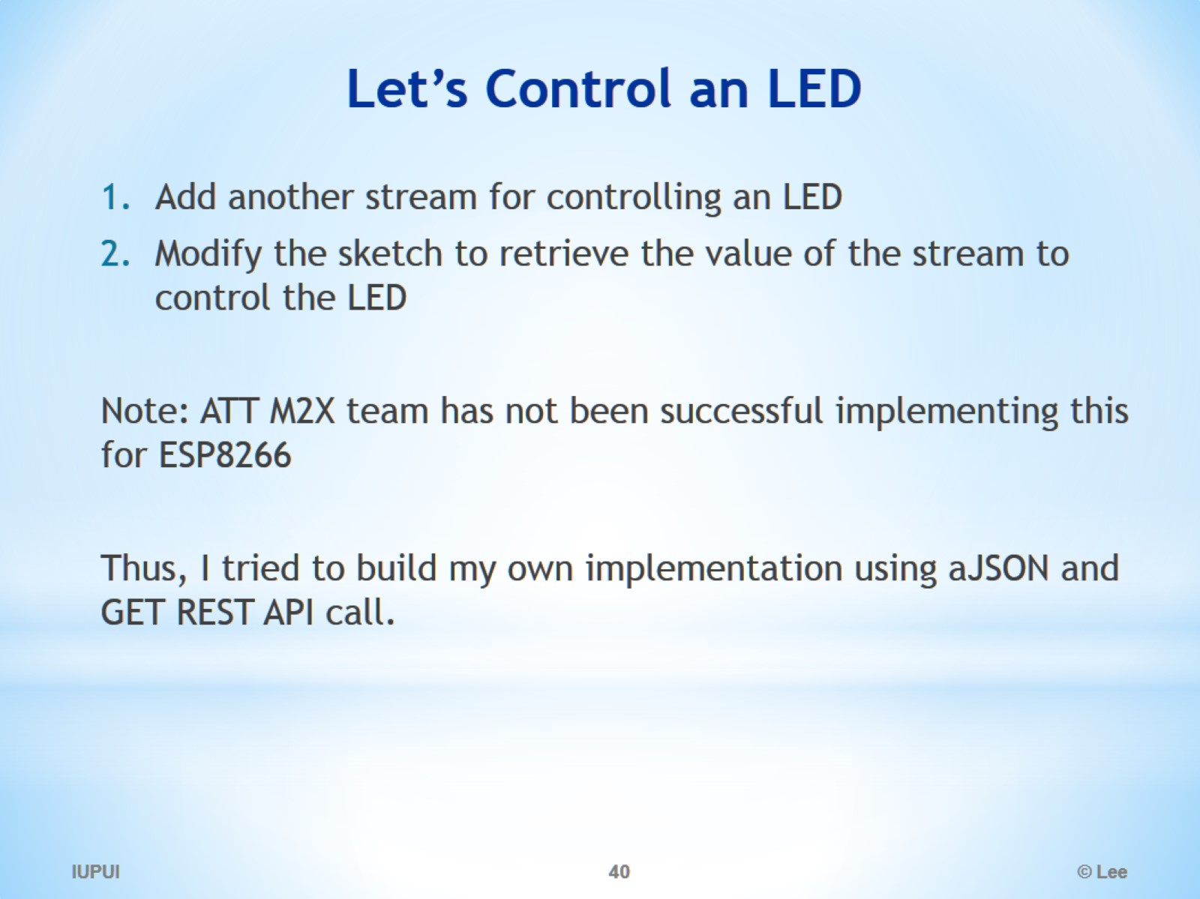
Let’s Control an LED

Slide 41
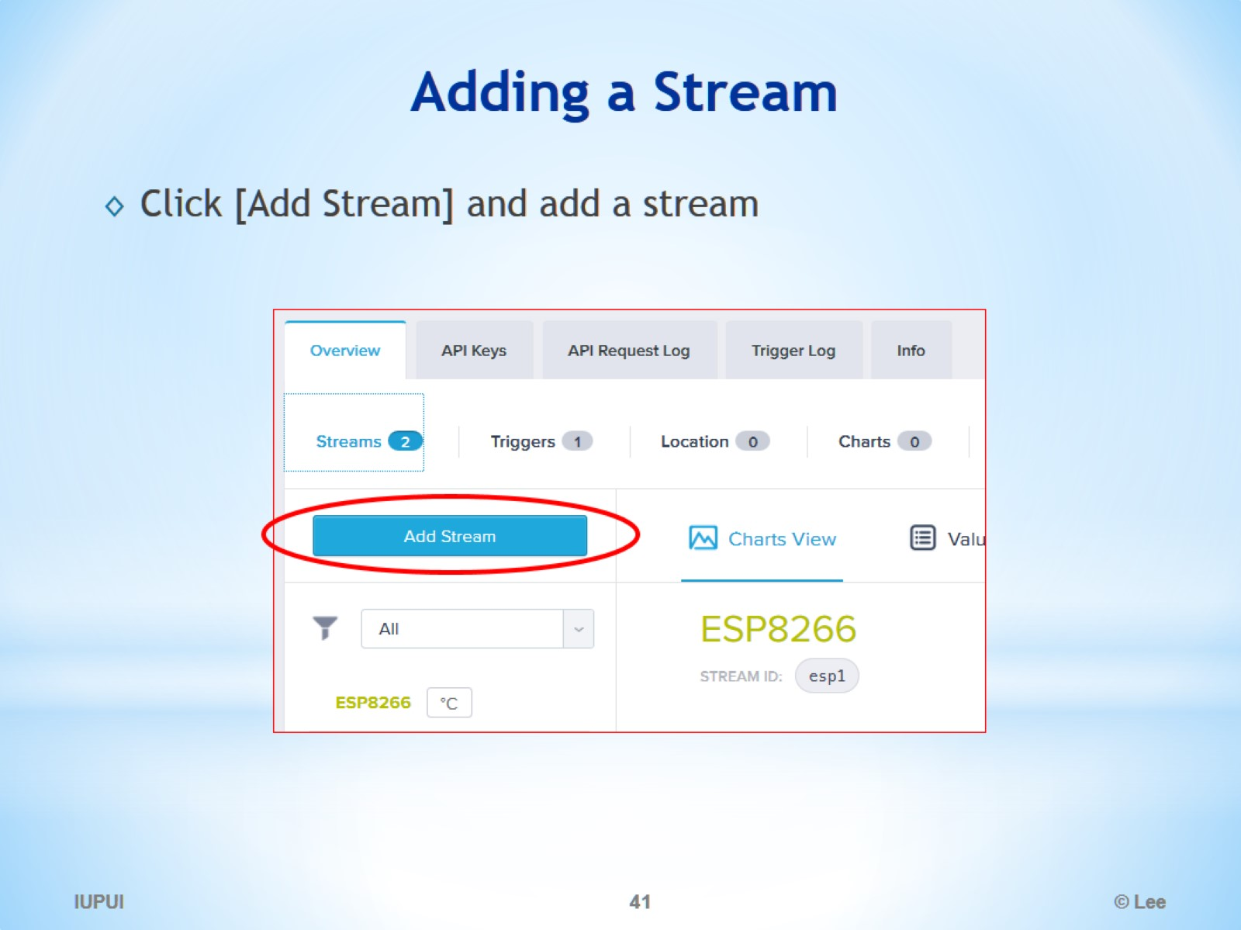
Adding a Stream

Slide 42
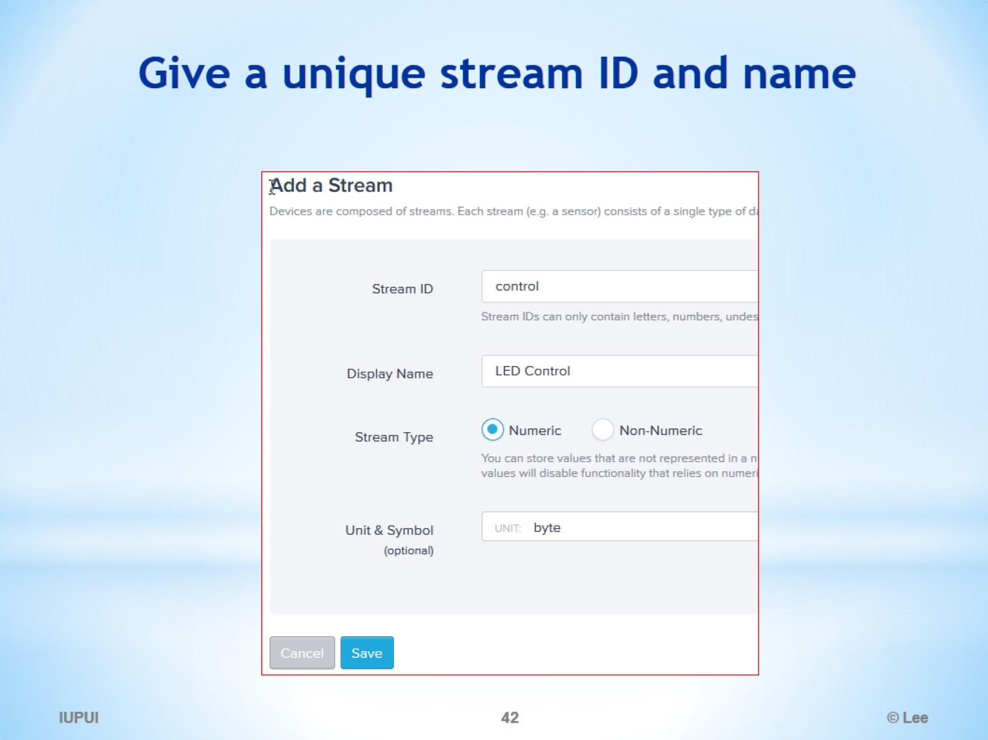
Give a unique stream ID and name

Slide 43
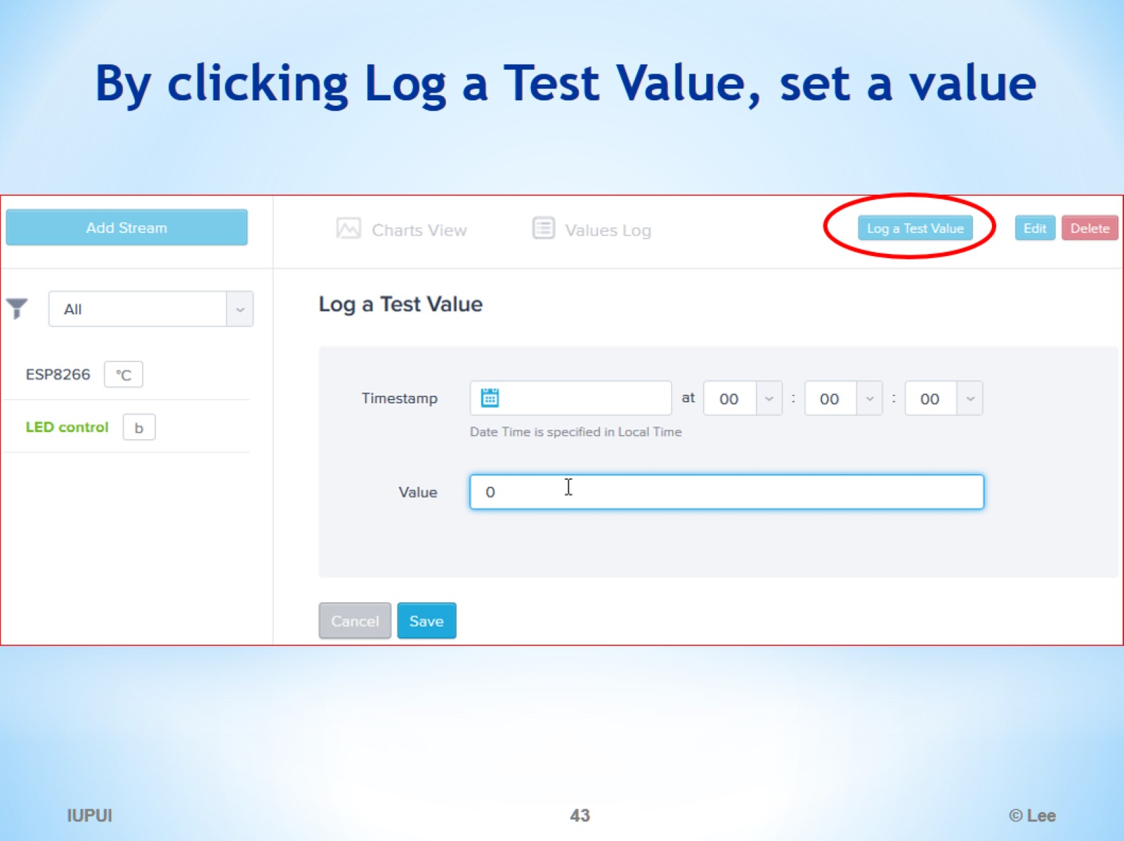
By clicking Log a Test Value, set a value

Slide 44
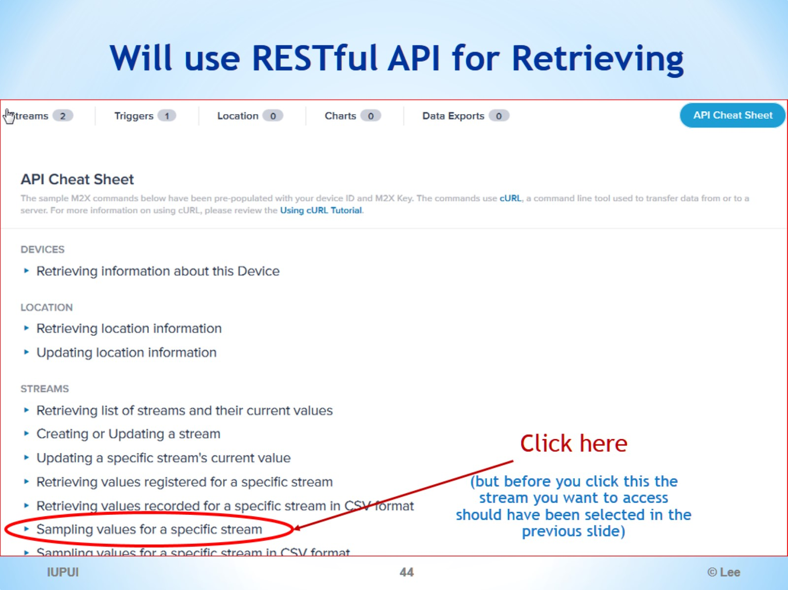
Will use RESTful API for Retrieving

Slide 45
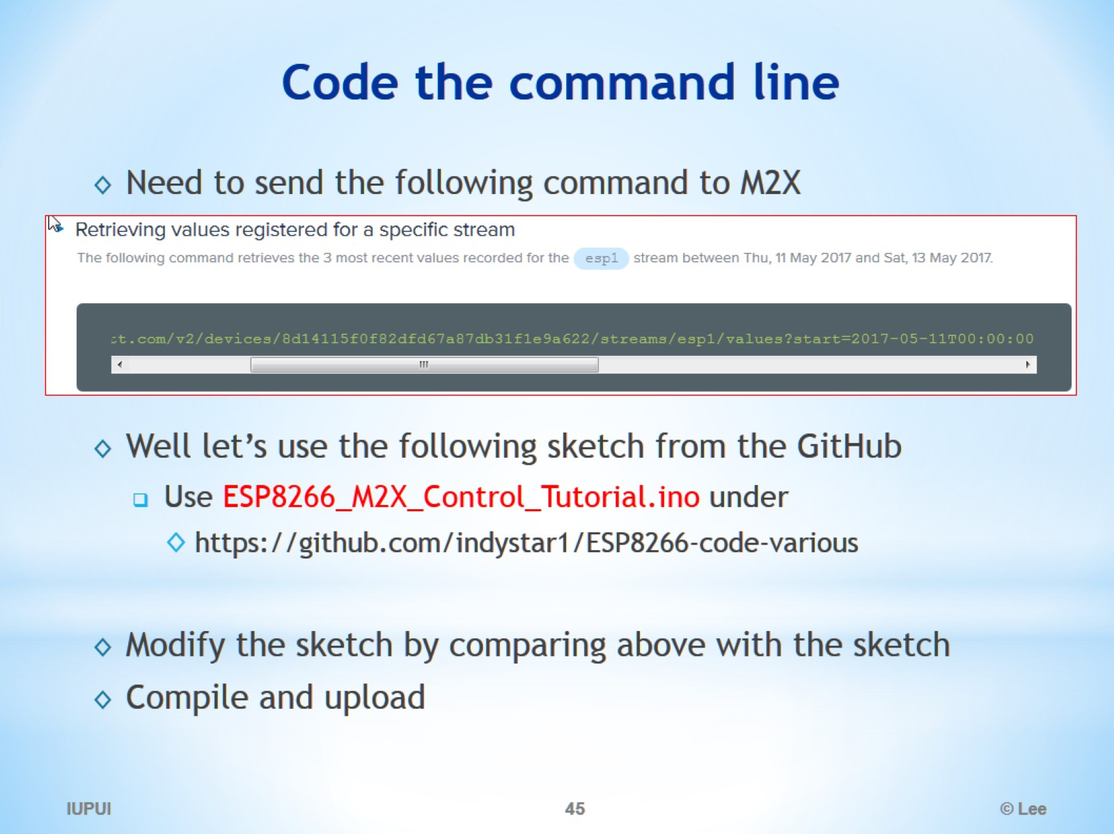
Code the command line

Slide 46
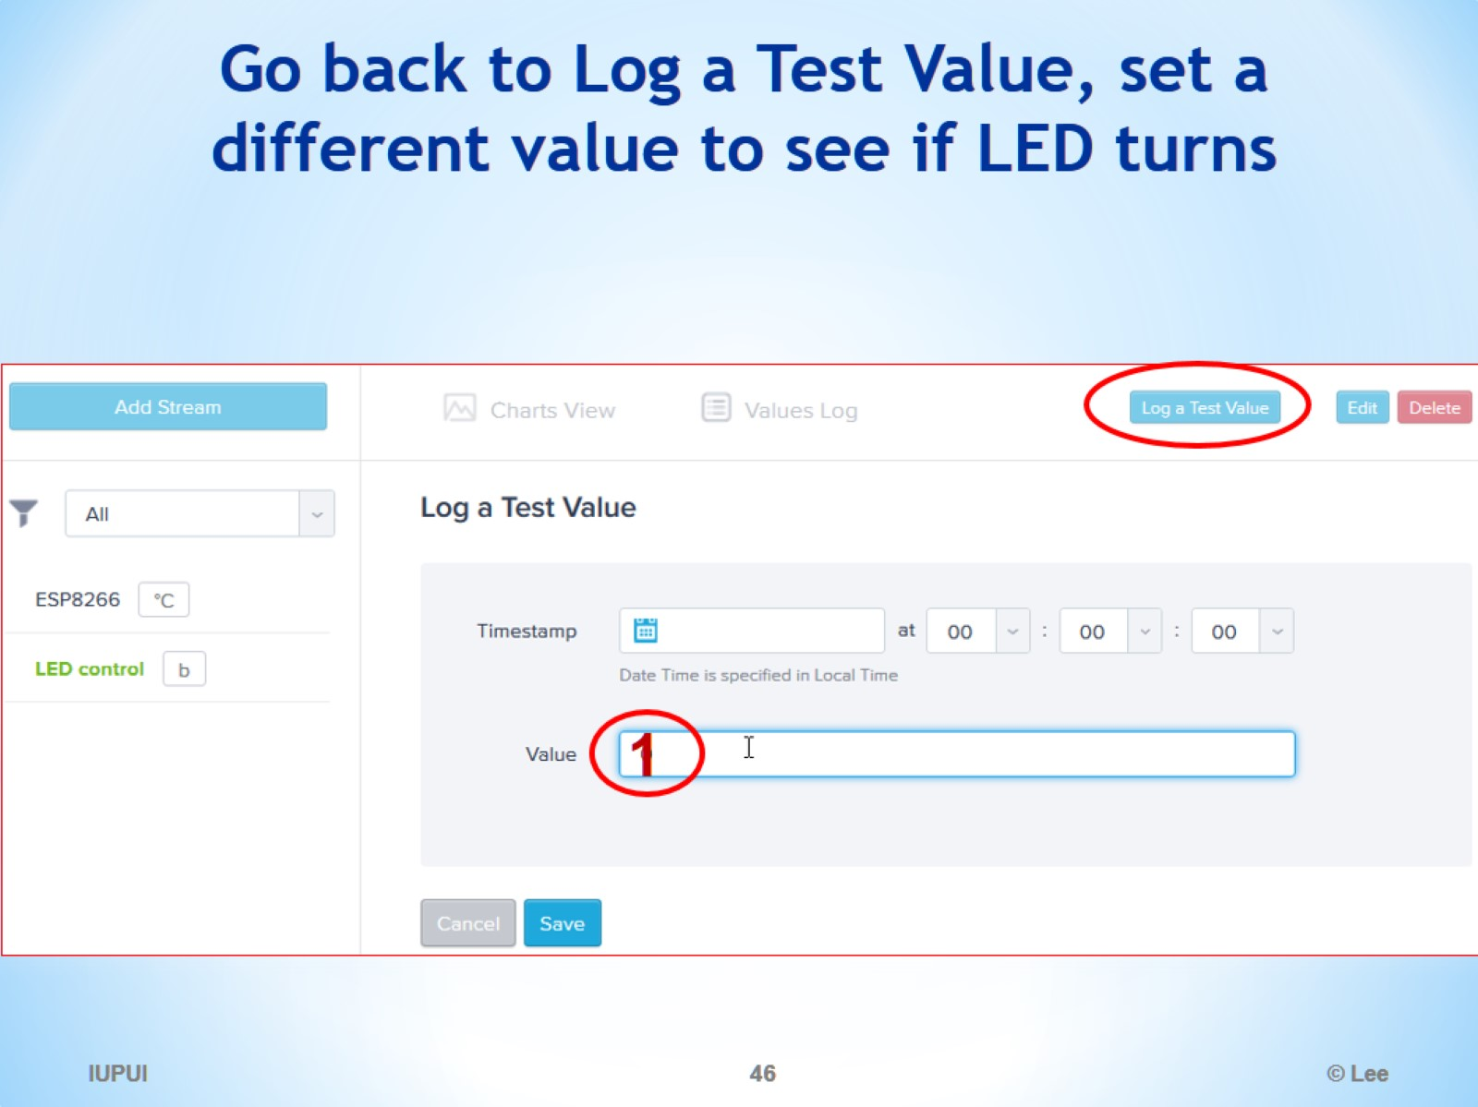
Go back to Log a Test Value, set a different value to see if LED turns

Slide 47
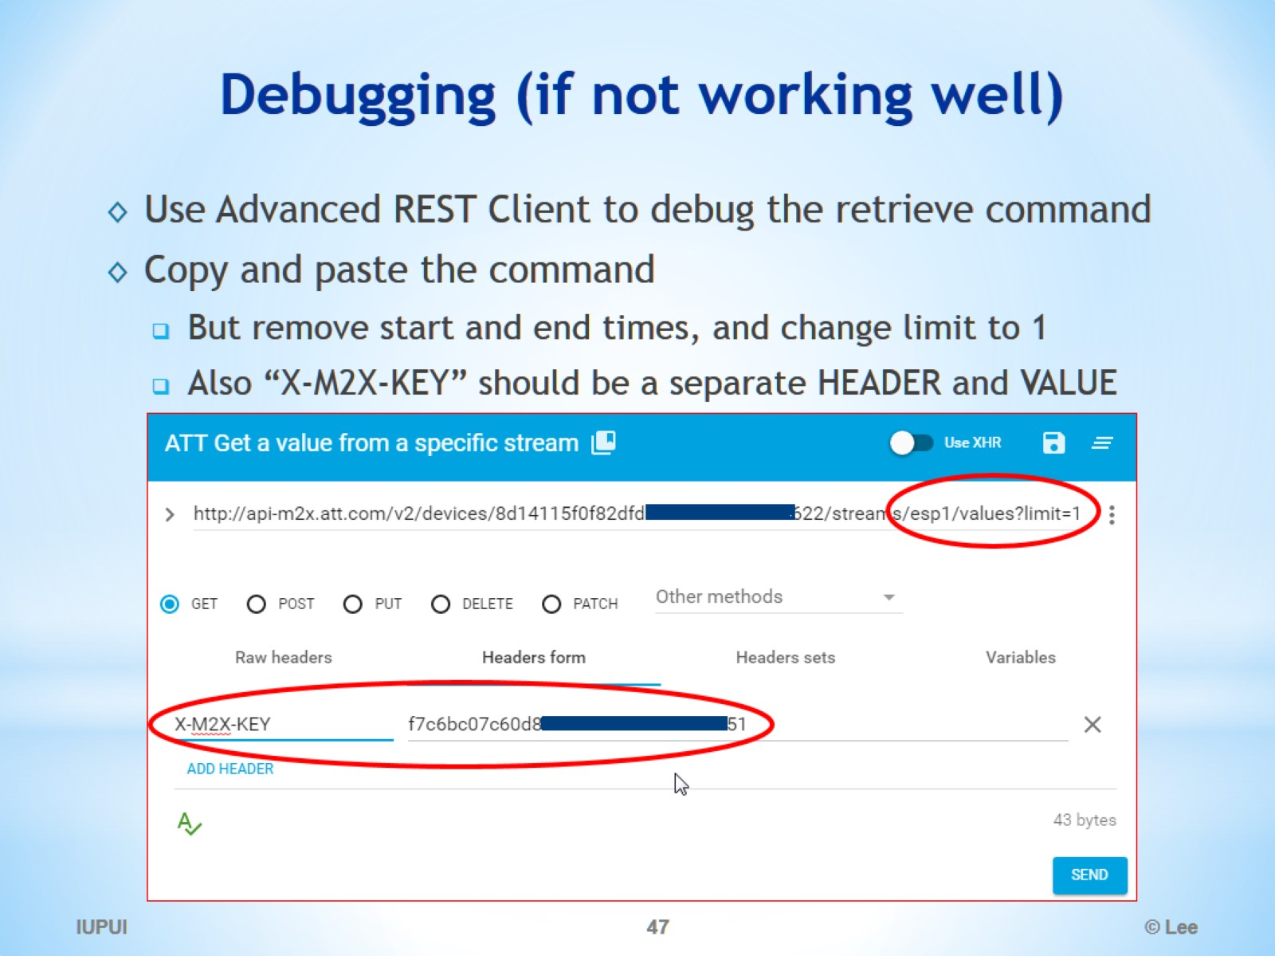
Debugging (if not working well)

Slide 48
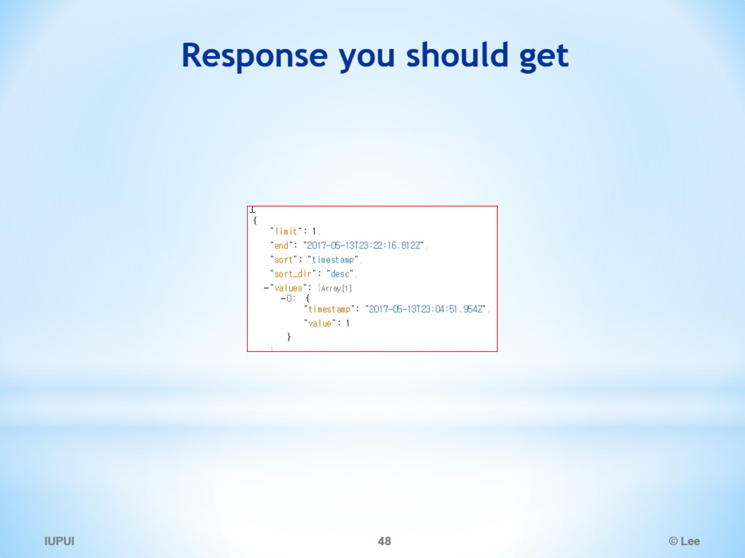
Response you should get

